Slide 1
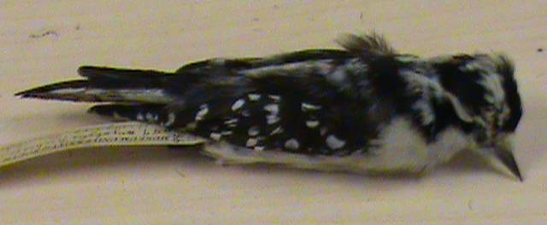
Downy Woodpecker

Slide 2
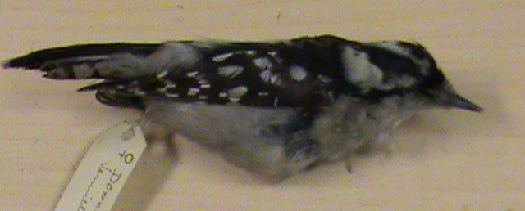
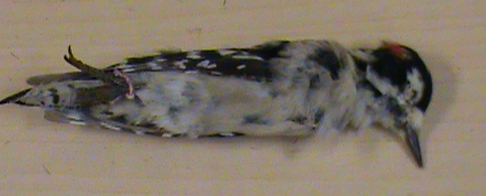
Downy Woodpecker

Slide 3
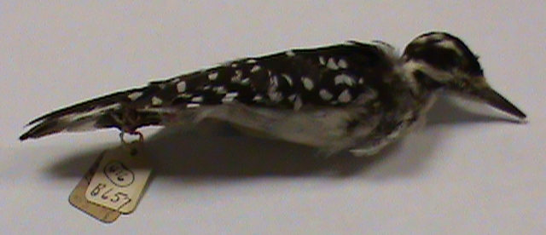
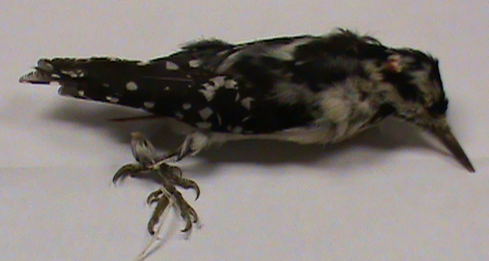
Hairy Woodpecker

Slide 4
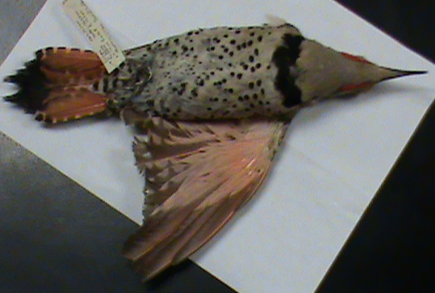
Northern Flicker (Red-shafted race)

Slide 5
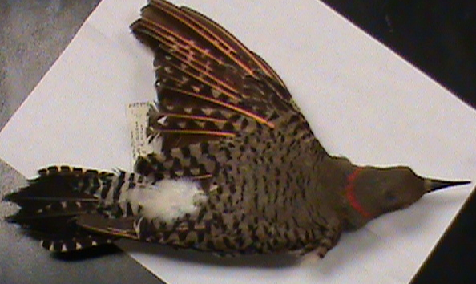
Northern Flicker (Red-shafted race)

Slide 6
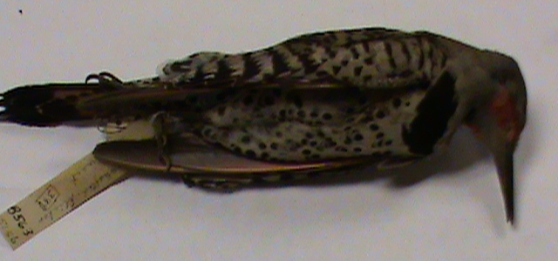
Northern Flicker (Red-shafted race)

Slide 7
Northern Flicker (Red-shafted X Yellow-shafted Intergrade)

Slide 8
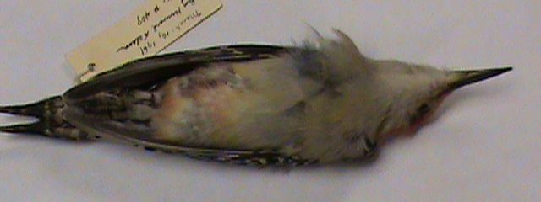
Red-bellied Woodpecker

Slide 9
Red-bellied Woodpecker

Slide 10
Yellow-bellied Sapsucker

Slide 11
Yellow-bellied Sapsucker

Slide 12
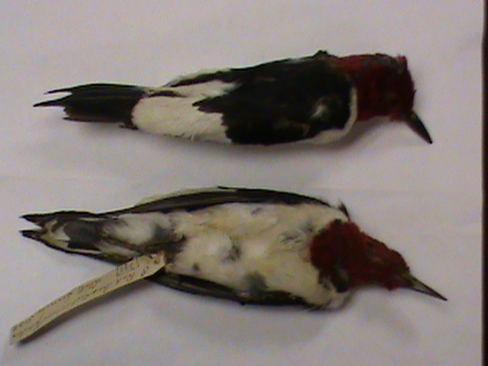
Red-headed Woodpecker

Slide 13
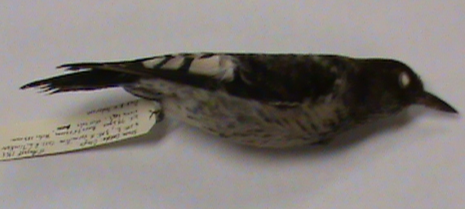
Red-headed Woodpecker (juvenile)

Slide 14
Red-headed Woodpecker (juvenile)

Slide 15
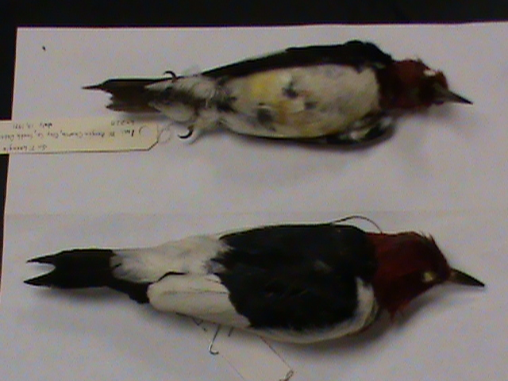
Red-headed Woodpecker

Slide 16
Lewis’s Woodpecker

Slide 17
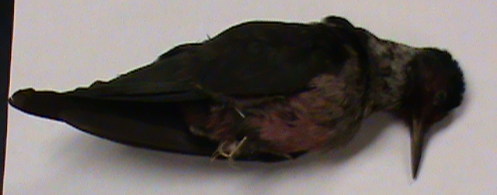
Lewis’s Woodpecker

Slide 18
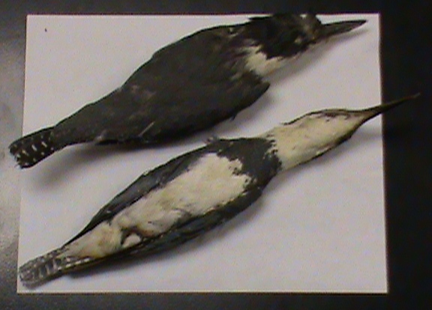
Belted Kingfisher

Slide 19
Belted Kingfisher

Slide 20
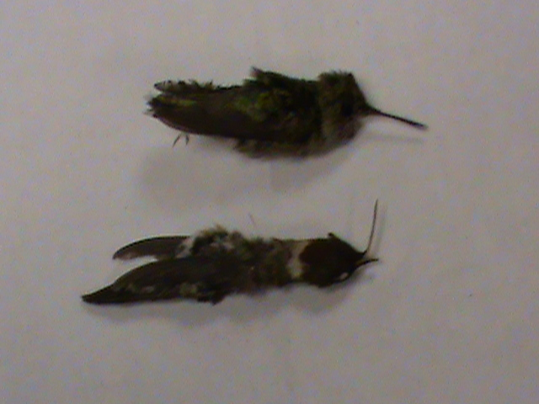
Ruby-throated Hummingbird
Top = female, Bottom = male

Slide 21
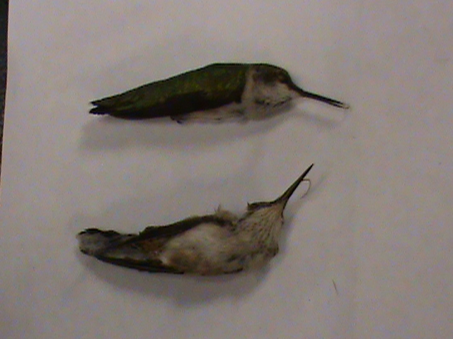
Ruby-throated Hummingbird (females)

Slide 22
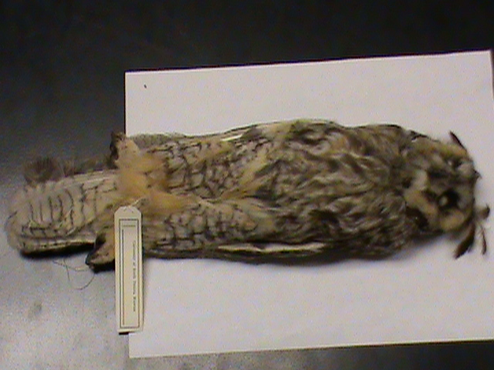
Long-eared Owl

Slide 23
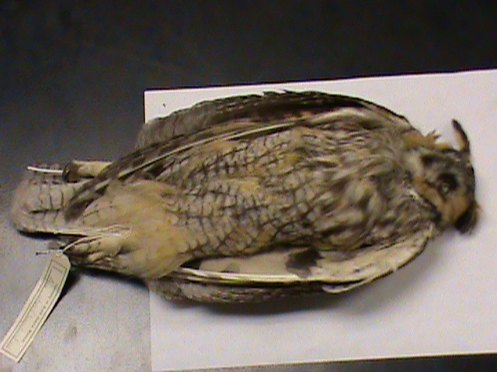
Long-eared Owl

Slide 24
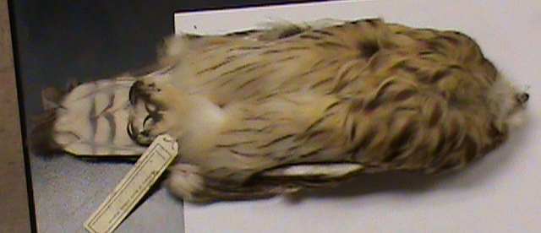
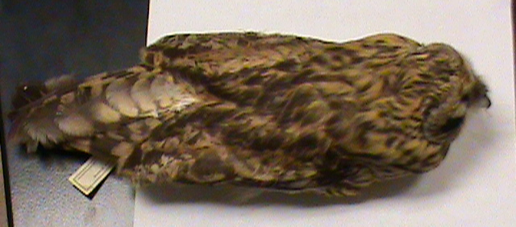
Short-eared Owl

Slide 25
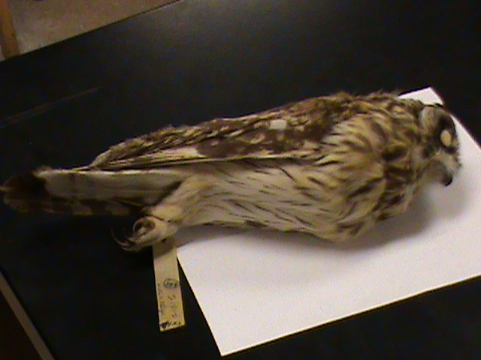
Short-eared Owl

Slide 26
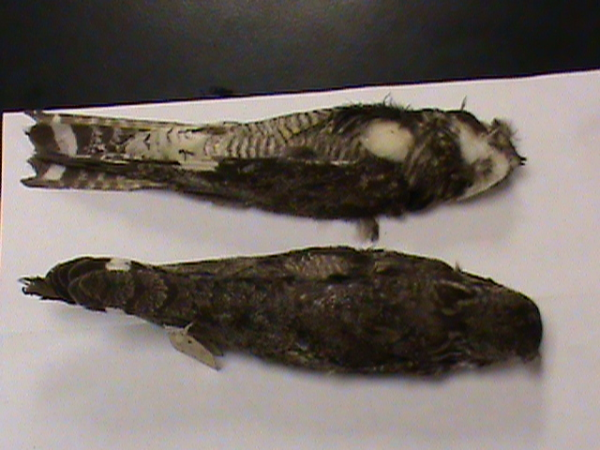
Common Nighthawk

Slide 27
Common Nighthawk

Slide 28
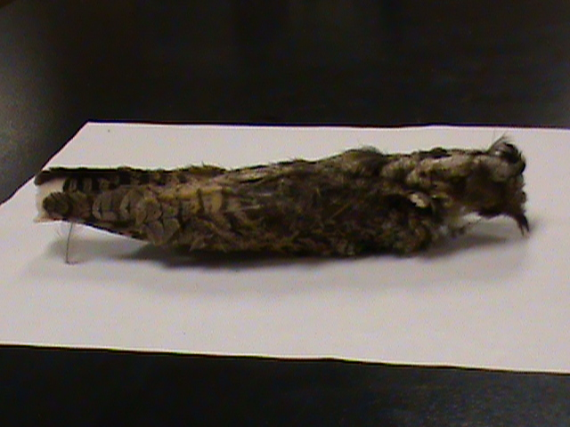
Common Nighthawk

Slide 29
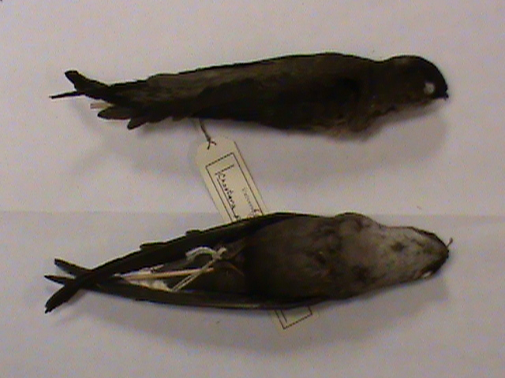
Chimney Swift

Slide 30
Chimney Swift

Slide 31
Chimney Swift

Slide 32
White-throated Swift

Slide 33
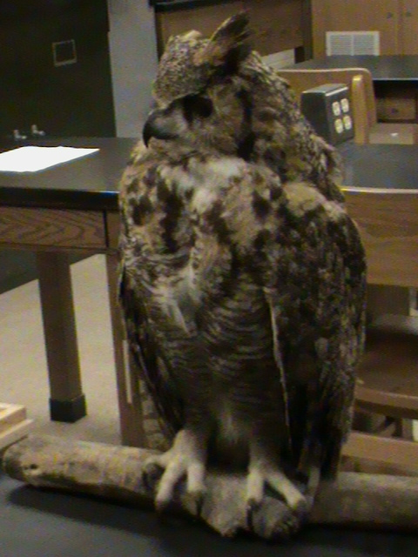
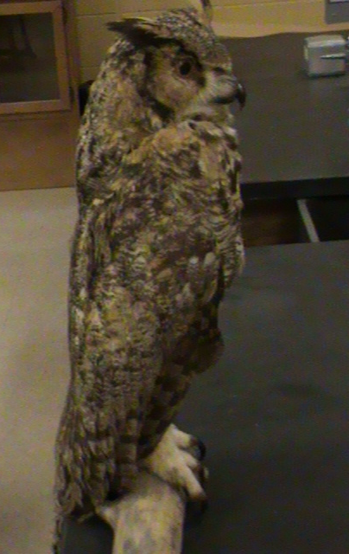
Great Horned Owl

Slide 34
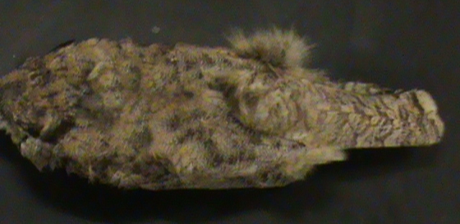
Great Horned Owl

Slide 35
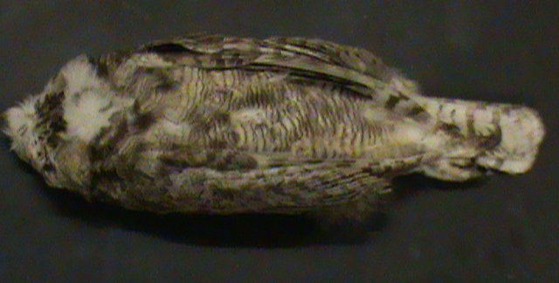
Great Horned Owl

Slide 36
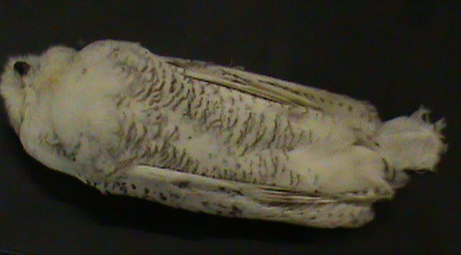
Snowy Owl

Slide 37
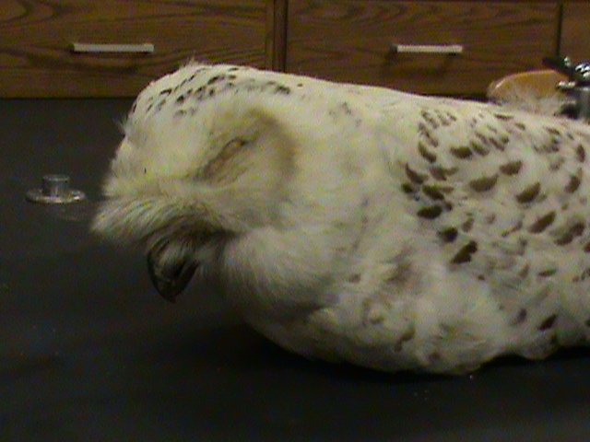
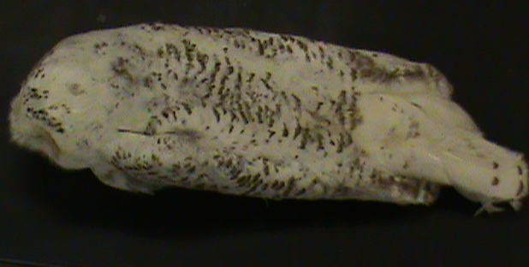
Snowy Owl

Slide 38
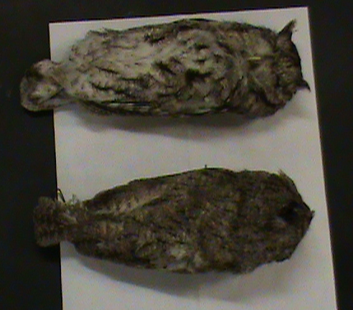
Eastern Screech-Owl

Slide 39
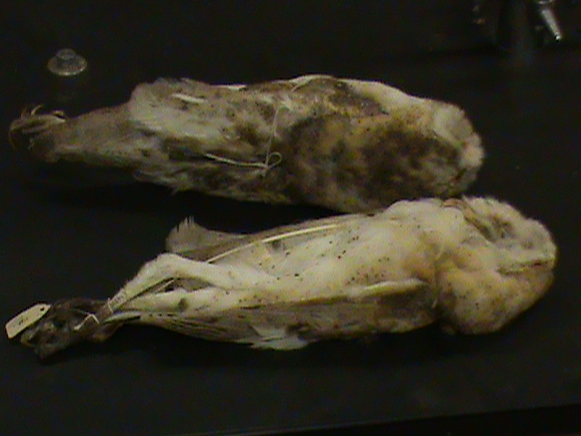
Barn Owl

Slide 40
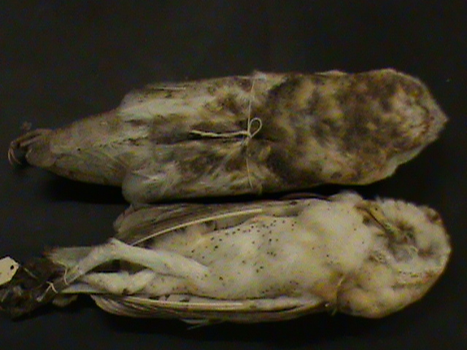
Barn Owl

Slide 41
Black-billed Cuckoo

Slide 42
Yellow-billed Cuckoo

Slide 43
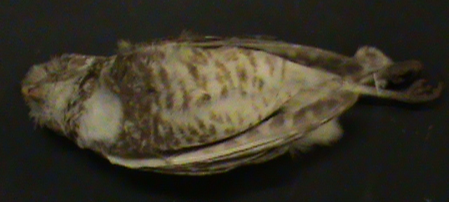
Burrowing Owl

Slide 44
Burrowing Owl

Slide 45
Mourning Dove

Slide 46
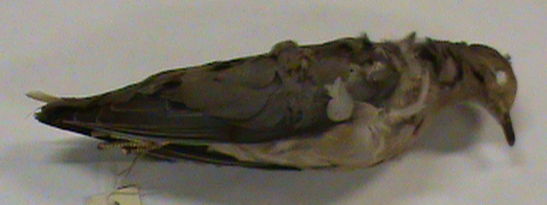
Mourning Dove

Slide 47
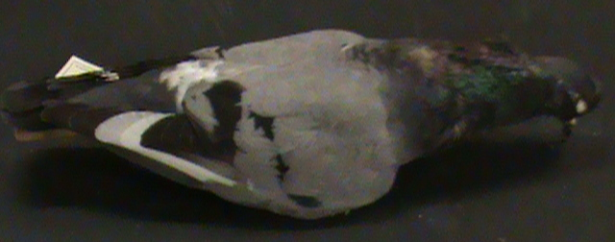
Rock Pigeon

Slide 48
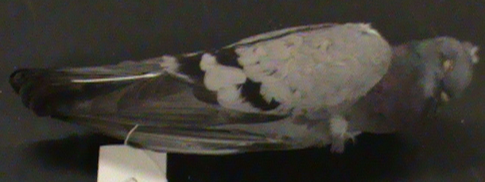
Rock Pigeon

Slide 49
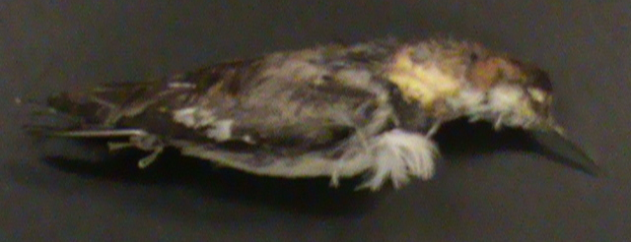
Red-necked Phalarope

Slide 50
Wilson’s Phalarope

Slide 51
Wilson’s Phalarope

Slide 52
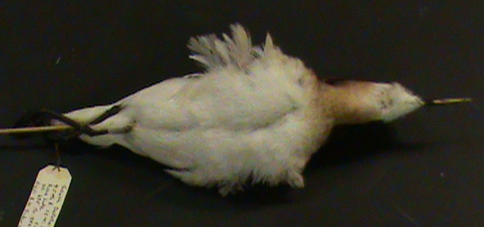

Slide 53
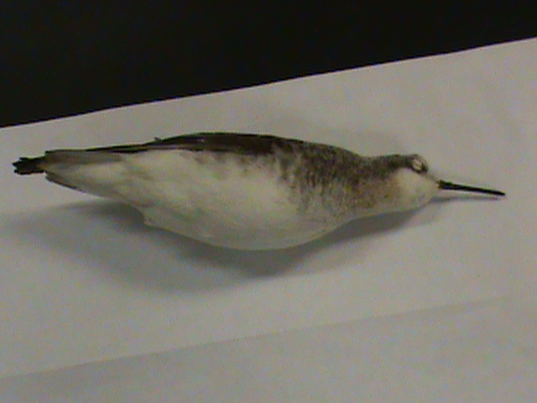
Wilson’s Phalarope

Slide 54
Wilson’s Phalarope

Slide 55
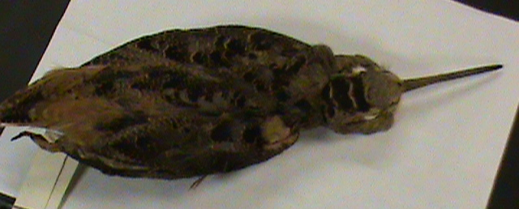
American Woodcock

Slide 56
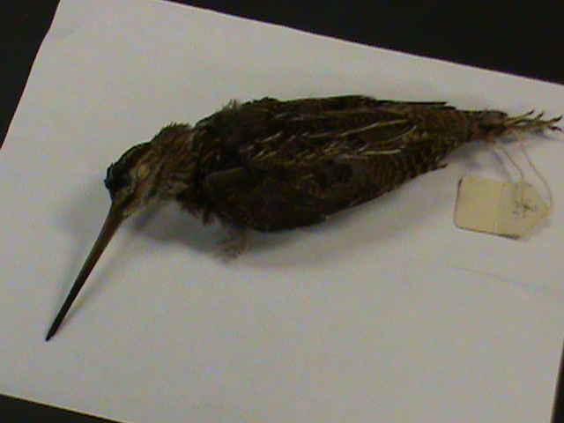
Wilson’s Snipe

Slide 57
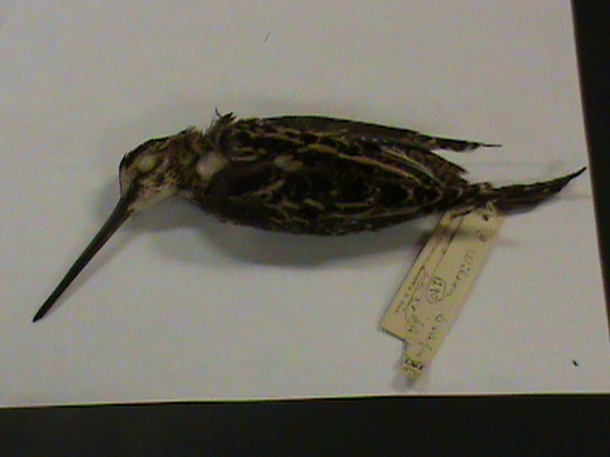
Wilson’s Snipe

Slide 58
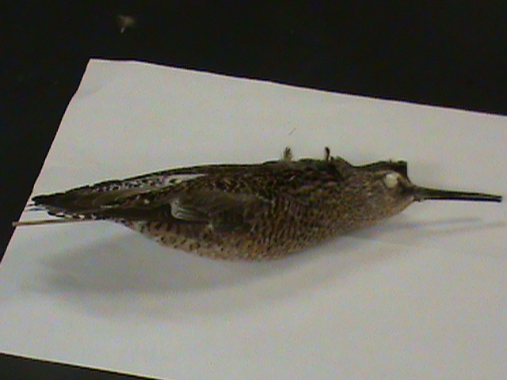
Long-billed Dowitcher

Slide 59
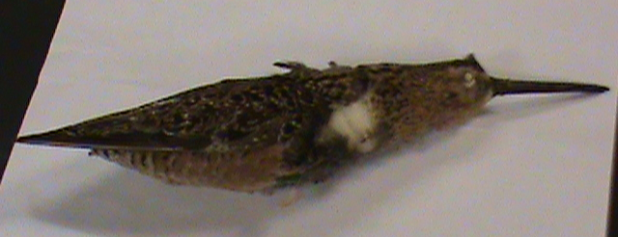
Long-billed Dowitcher

Slide 60
Long-billed Dowitcher

Slide 61
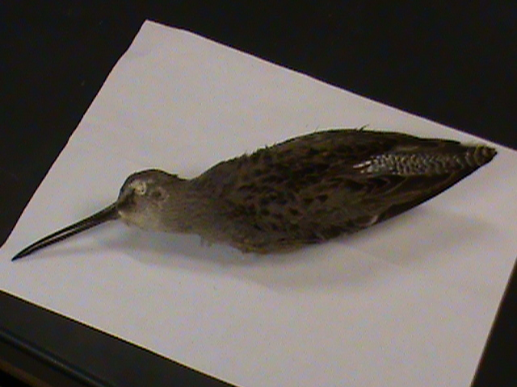

Slide 62
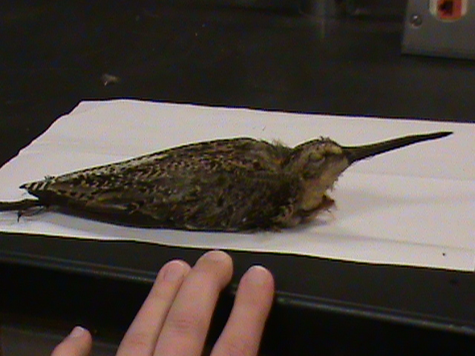

Slide 63
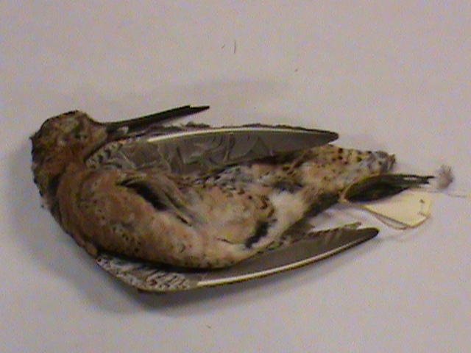

Slide 64
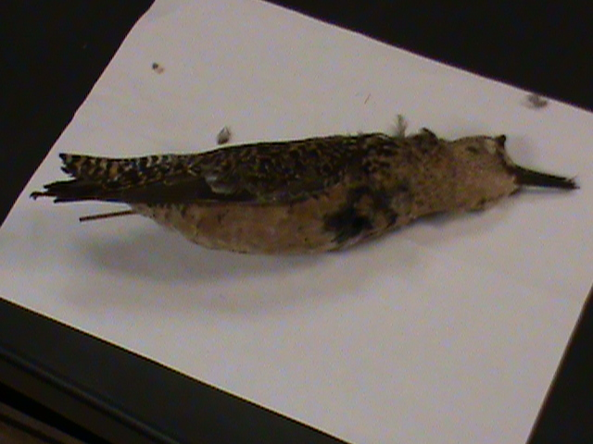
Short-billed Dowitcher

Slide 65
White-rumped Sandpiper

Slide 66
Pectoral Sandpiper

Slide 67
Pectoral Sandpiper

Slide 68
Pectoral Sandpiper

Slide 69
Dunlin

Slide 70
Dunlin (winter plumage)

Slide 71
Dunlin (winter plumage)

Slide 72
Dunlin (winter plumage)

Slide 73
Stilt Sandpiper

Slide 74
Stilt Sandpiper

Slide 75
Stilt Sandpiper

Slide 76
Hudsonian Godwit

Slide 77
Hudsonian Godwit

Slide 78
Hudsonian Godwit

Slide 79
Ruddy Turnstone

Slide 80
Sanderling (winter)

Slide 81
Sanderling (winter)

Slide 82
Sanderling (winter)

Slide 83
Sanderling (winter)

Slide 84
Sanderling (winter)

Slide 85
Sanderling (winter)

Slide 86
Sanderling (winter)

Slide 87
Semipalmated Sandpiper

Slide 88
Semipalmated Sandpiper

Slide 89
Western Sandpiper

Slide 90
Least Sandpiper

Slide 91
Least Sandpiper

