Slide 1
Water Absorption in Frogs
Frogs capable of absorbing water from moisture at soil surface or on wet or dewy vegetation or rocks.
Accomplished by assuming water-absorbing posture with hind legs splayed and ventral surface of legs and abdomen pressed to substrate.
Aquaporins (water channels) in skin are involved.
These Aquaporins were the topic of the Ogushi et al (2010) paper

Slide 2
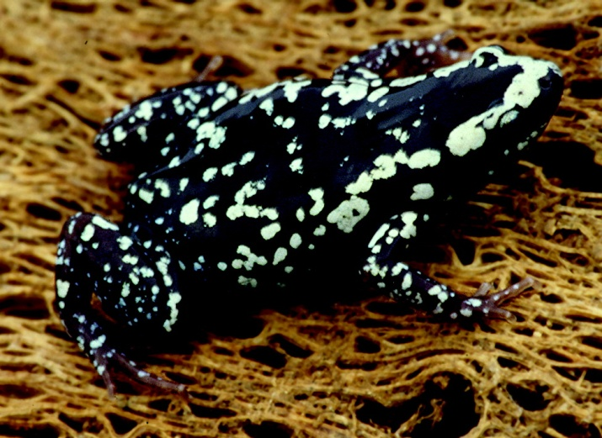
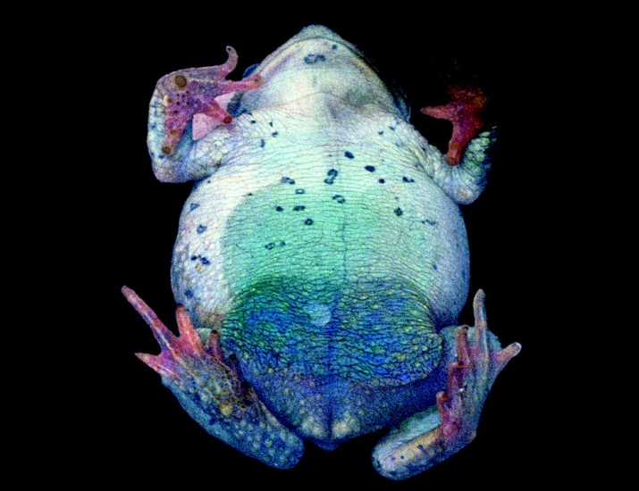
Typical water-uptake posture for frogs.
Note that the legs are splayed out and the ventral surface is in contact with the substrate.
Water-absorbing patch on ventral skin
surface that contains aquaporins.

Slide 3
Water Absorption in Frogs
Semiterrestrial frog water balance strategy:
Take up water across ventral skin surface (i.e., pelvic patch or seat patch) when water available
Store water in urinary bladder (large capacity for storage)
Take water up from bladder as needed during desiccating conditions
Seat Patch contains aquaporins = plasma membrane proteins forming water channels into cells (present in almost all organisms)
Control water permeability across membranes
Stimulated by arginine vasotocin (AVT): causes fusion of vesicles containing AQPs with apical surface of epithelial membrane of water absorption-reabsorption tissues

Slide 4
Table 1. Phylogenetics of aquaporins in ventral pelvic skins of anuran species living in different habitats
 |  | Pelvic Skin |  | Bladder
Habitat | Species | AQP-h2-like Protein ( Bladder-Type) | AQP-h3-Like cDNA (Ventral Pelvic-Type) | AQP-h2-Like Protein (Bladder-Type)
Arboreal | Hyla japonica | + | + | +
Terrestrial | Bufo japonica | + | + | +
Semi-aquatic | Rana catesbeiana | - | + | +
Semi-aquatic | Rana nigromaculata | - | + | +
Semi-aquatic | Rana japonica | - | + | +
Aquatic | Xenopus laevis | - | + | +

Slide 5
Hypotheses and Study Species
Water permeability and its regulation differ among frogs and toads depending on habitat (dry vs. moist)
Phylogenetic relationships also influence water permeability and its regulation in anurans
Study species included 1 arboreal, 1 terrestrial, 3 semi-aquatic and 1 aquatic species of frogs

Slide 6
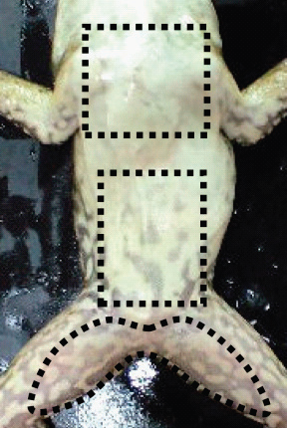
Methods
Immunohistochemistry – visualizes distribution of Aquaporins in skin regions
Western Blots – localize and quantify Aquaporin proteins present in ventral skin regions
Water Permeability Experiments
Measured from isolated ventral skin in fully hydrated state
Measured in response to AVT, hydrin 1 and hydrin 2 (all increase water permeability; hydrins only in skin, AVT in skin and bladder)
III
II
I

Slide 7
Important Results
Semi-aquatic Species …
Rana japonica and R. nigromaculata with AQP-h3 in hindlimb regions, but not in pelvic or pectoral regions
R. catesbiana AQP-h3: hindlimb > pelvic > pectoral (very limited in pectoral)
AVT stimulated water uptake in quantitatively similar fashion to AQP-h3 distribution in all three species
Terrestrial Species …
Bufo marinus with AQP-h3 and AQP-h2 in all ventral skin regions (some evidence for lower levels in pectoral)
AVT stimulated increases water uptake in all 3 regions (greatest in hindlimb or pelvic regions)
AVT & hydrin stimulation of water permeability greater in semi-aquatic than in terrestrial species
AVT did not ↑ water perm across skin in aquatic X. laevis

Slide 8
Conclusions
AQP response to AVT and hydrins varied across habitats (lowest in aquatic habitats)
↑ in semi-aquatic and terrestrial, no change in aquatic
Terrestrial and arboreal species (driest habitats) with two different AQPs (AQP-h3 & AQP-h2) expressed in skin; anurans from all habitats with AQP-h3 in skin, AQP-h2 in bladder
Aquatic X. laevis expresses AQP-h3 in skin, but mRNA is not translated.
Consistent with absence of stimulatory effects of AVT and hydrin on skin water permeability in this species.

Slide 9
Conclusions
Phylogeny based on AQP types and distribution …
Rana japonica
Rana nigromaculata
Rana catesbiana
(sometimes classified as Lithobastes)
Hyla japonica
Bufo marinus
Xenopus laevis
This phylogenetic scenario consistent with other data

