Slide 1
Intra-individual variation allows an explicit test of the hygric hypothesis for discontinuous gas exchange in insects
Caroline M. Williams1, Shannon L. Pelini2,†,
Jessica J. Hellmann2 and Brent J. Sinclair

Slide 2
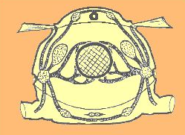
Introduction
Insect Respiratory System consists of:
Tracheal Tubes:
External Spiracular Valves:
http://www.cals.ncsu.edu/course/ent425/tutorial/respire.html

Slide 3
Introduction
Two primary patterns of gas exchange in insects. Discontinuous gas exchange cycles (DGCs) Continuous gas exchange (CGE)
DGCs consist of three phases: Closed phase—spiracles close, no gas exchange Flutter phase—spiracles rapidly open and close, air inflow Open phase— spiracles open, unrestricted gas exchange

Slide 4
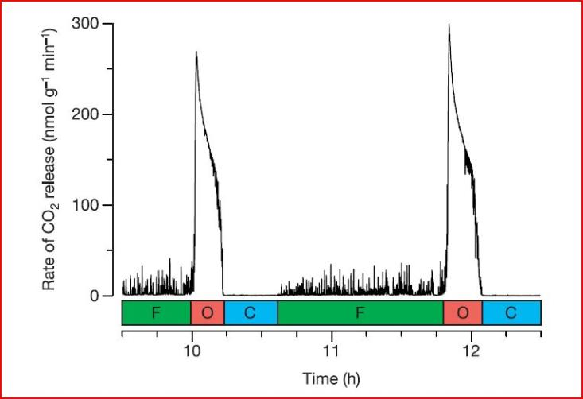
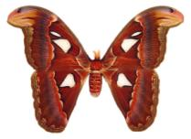
Discontinuous Gas Exchange

Slide 5
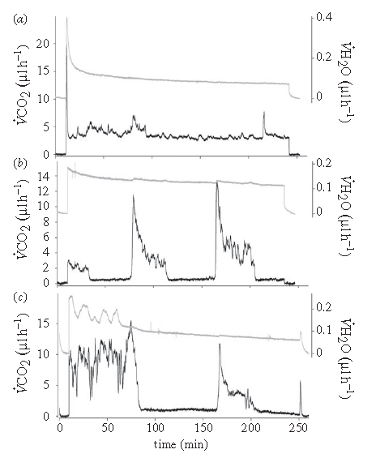
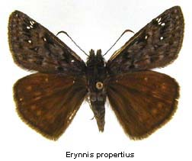
CO₂ production = MR
Figure 1
= continuous gas exchange
= discontinuous gas exchange
= continuous, then discontinuous, gas exchange
Water loss

Slide 6
Three Hypothesis
The hygric hypothesis
DGCs have evolved to limit respiratory water loss (RWL) by maximizing the time that the spiracles are closed
The chthonic – hygric hypothesis
DGCs originated in insects inhabiting hypoxic and hypercapnic environments to increase O₂ and CO₂ diffusion gradients, also water savings.
The oxidative damage hypothesis
DGCs minimize oxidative damage during periods of low metabolic demand by maintaining low tracheal PO₂ while retaining delivery capacity during periods of high metabolic demand

Slide 7
Introduction
In this paper, the authors focus on the hygric hypothesis.
Predictions …
Water lost per CO₂ released will be lower for insects using DGCs
DGCs will decrease RWL
Previous studies show:
RWL is greater when the spiracles are open
DGCs are longer in xeric (dry) environments, continuous patterns are more common in mesic (moist) habitats
RWL was lower in individual ants that did not express DGCs, however, they have lower MR so lower water loss may be due to lower MR.
Manipulation of environmental variables can force insects to abandon DGCs.

Slide 8
Introduction
Comparisons of RWL in individuals that use both DGCs and continuous gas exchange (CGE) under ecologically relevant conditions.
Specific Predictions:
The ratio of water loss to CO₂ emission will be lower during DGCs than during CGE
The contribution of RWL to total water loss will be lower during DGCs

Slide 9
Material and Methods
Erynnis propertius
Under benign conditions, individuals use both DGCs and CGE, allowing a direct comparison of water loss rates both between and within individuals during DGCs and CGE.

Slide 10
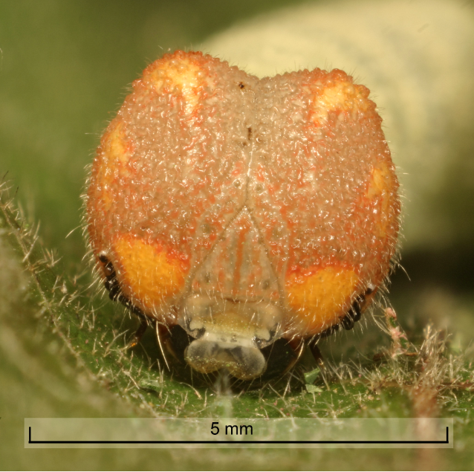
Material and Methods
Larvae were caught in Oregon and British Columbia, and reared until the sixth instar.
Then, larvae were housed in incubators. Total water content was determined for nine individuals.
Volume of water and CO₂ released per unit time were measured for 4 h after 3 h acclimation using flow-through respirometry.

Slide 11
Statistical Methods
ANCOVA
Compared between modes with the covariates mass and time
Between individuals was also compared with the covariates mass and time
Cuticular water loss for all individuals and modes was compared with total water loss as a covariate.
RWL was calculated with cuticular water loss as a covariate
t-test
H₂O/CO₂ slopes were compared between CGE and DGCs

Slide 12
Results
CO₂ production (MR) did not differ between gas exchange patterns either within or between individuals
Water loss was significantly lower during DGCs than during CGE both within and between individuals
The ratio of H₂O to CO₂ was higher during CGE between individuals
RWL accounted for significantly more of the total water loss during CGE both between and within individuals
The slopes of the regression of H₂O on CO₂ were higher during CGE than during DGCs between but not within individuals
Cuticular water loss did not differ between DGCs and CGE either between or within individuals

Slide 13
Table 1

Slide 14
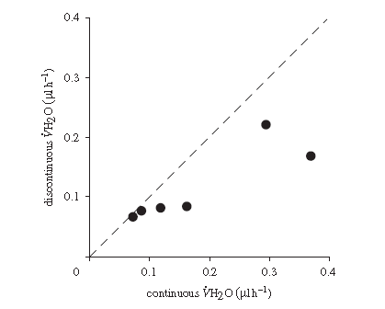
Figure 2.
Water loss is less for DGE than for CGE in this species.

Slide 15
Discussion
Water loss in E. propertius is higher during CGE, both within individuals that use both patterns and between individuals. Thus, in this species, a DGC appears to confer a significant water conservation benefit. Suggests that water conservation is an advantage that could lead to the origin or maintenance of DGCs in insects.
Only six of the 39 caterpillars we observed switched gas exchange modes. Authors suggest this results from the short (4 h) observation period

Slide 16
Discussion
In Pogonomyrmex barbatus, DGC was abandoned at higher metabolic rates (Gibbs & Johnson 2004), but the authors found no difference in CO₂ production (MR) between E. propertius individuals using DGCs and CGE.
This challenges the oxidative damage hypothesis, which predicts that metabolic rate should determine the mode of gas exchange.
Whether RWL reduction during DGCs confers a fitness advantage requires further investigation.

