Slide 1
Anaerobic Metabolism
Main pathway in Vertebrates = Glycolysis (catabolism of carbohydrates)
ATP production by glycolysis begins rapidly after initiation of activity or exposure to hypoxia/anoxia.
Begins after stores of phosphagens (ATP, creatine phosphate, arginine phosphate – cephalopods) are depleted.
Rapid production of ATP via anaerobic pathways requires rapid mobilization of stored substrate (storage form of carbohydrate in animals = glycogen).
Main stores of glycogen in the body are in the liver, but stores are also present in the heart and in skeletal muscle.
Skeletal muscle stores important for burst activity.
Glucose → 2 moles ATP per mole glucose
Glycogen → 3 moles ATP per mole glucose
Difference in ATP production due to active phosphorylation of glucose to glucose-6-phosphate

Slide 2
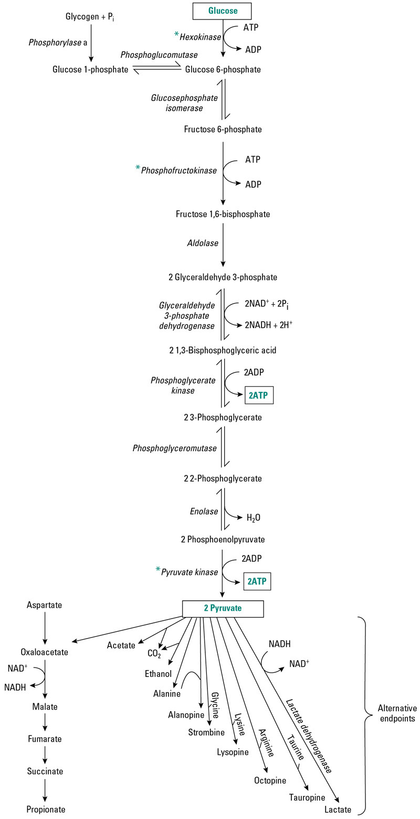
- 1 ATP
- 1 ATP
Fig 6.6 – Glycolysis pathways
and key side pathways
* denote key regulatory sites

Slide 3
Anaerobic Metabolism
Rate at which glycolysis proceeds is determined by activities (or concentration) of component enzymes, especially regulatory or rate-limiting enzymes = catalyze the slowest step in a multi-step pathway so limit the rate at which the entire process may proceed.
Glycolysis Regulatory Enzymes:
Phosphofructokinase (PFK) = major regulatory enzyme for glycolysis
Inhibitors = ATP, citrate, fatty acids
Activators = ADP, AMP, fructose-2,6-P₂
Pyruvate Kinase (PK)
Inhibitors = ATP, citrate, alanine
Activators = PEP, fructose-1,6- P₂
Glycogenolysis – limited by glycogen phosphorylase, which is activated by phosphorylation
Allosteric modifiers: Activators = AMP, glucose; Inhibitors = ATP, glucose-6-P
Terminal Stage in glycolysis in vertebrates (and some invertebrates, but to a lesser degree) is catalyzed by lactate dehydrogenase.
Pyruvate ↔ Lactate (ΔG favors lactate)

Slide 4
Fig 6.6 – Glycolysis pathways
and key side pathways
* denote key regulatory sites

Slide 5
Anaerobic Metabolism
Alternative Routes to lactate exist at two points in glycolytic pathway
Alternative at terminal branch point
In many invertebrates, lactate dehydrogenase is “replaced” by functionally analogous imino acid dehydrogenases, so that imino acids accumulate as glycolytic end products.
Basically serves to combine pyruvate + amino acid
No change in ATP yield
These alternative are used by invertebrates under conditions of hypoxia or anoxia (e.g., tidal molluscs)
These alternative routes also generate NAD⁺ from NADH, so allow sustained anaerobic metabolism, although with low power.

Slide 6
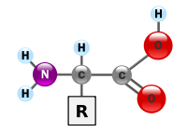
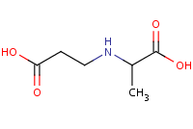
Amino Acid
Imino Acid
Example Reaction:
beta-alanine + pyruvate + NADH + H⁺ ↔ beta-alanopine + NAD⁺ + H₂O
Β - alanopine

Slide 7
Fig 6.6 – Glycolysis pathways
and key side pathways
* denote key regulatory sites

Slide 8
Anaerobic Metabolism
Adaptation at PEP branch point
Glycolysis normally proceeds PEP → Pyruvate → Lactate (or some alternative)
Alternate route = PEP → Oxaloacetate → → → → Propionate
Catalyzed by Phosphoenolpyruvate carboxykinase (PEPCK)
This route characterized by low activities of PK and LDH, high levels of PEPCK
Also regenerates NAD⁺ and provides up to 6 moles ATP per mole glucose.
Allows sustained anaerobiosis, but again with low power.
Present in Molluscs, Roundworms (Nematodes), Parasitic flatworms (Platyhelminthes)

Slide 9
Fig 6.6 – Glycolysis pathways
and key side pathways
* denote key regulatory sites
Alternatives at PEP branch point
PEPCK
Alternatives at terminal branch point

Slide 10
Anaerobic Metabolism
Fermentation of Aspartate (an amino acid)
Pathway = Aspartate + α-ketoglutarate → glutamate + oxaloacetate
Oxaloacetate → → → → Propionate (same pathway as alternate PEP route)
Also a sustainable anerobic pathway.
To sustain, requires that α-ketoglutarate is regenerated.
This is accomplished by … Glutamate + pyruvate → alanine + α-ketoglutarate (alanine accumulates as an end product)
Used by molluscs (particularly intertidal bivalves)

Slide 11
Fig 6.6 – Glycolysis pathways
and key side pathways
* denote key regulatory sites
alanine
α-ketoglutarate
glutamate
pyruvate

Slide 12
Anaerobic Metabolism
Evolutionary trend is toward higher levels of activity in advanced invertebrates. This trend continues throughout vertebrate evolution.
Associated with this trend is a tendency for lesser reliance on sustained anaerobic pathways and greater used of arginine phosphate (cephalopods), creatine phosphate, and lactate, with their high power output, which is necessary to fuel intense activity.

Slide 13
Aerobic Metabolism
Pathways are available to use carbohydrates, fats, and proteins.
All substrates eventually feed into the Krebs Cycle (occurs in mitochondrial matrix), which feeds electrons (in the form of NADH or FADH₂ = reducing equivalents) into the electron transport system of the inner mitochondrial membrane.
The ETS generates ATP.

Slide 14
Krebs Cycle
Krebs Cycle completely oxidizes carbon molecules in substrates to CO₂.
For example, 6-C glucose completely oxidized to 6 molecules of CO₂.
In contrast, anaerobic glycolysis catabolizes 6-C glucose to two 3-C lactate molecules.
This increased oxidation markedly amplifies the yield of ATP (38 ATP per glucose vs. 2 for anaerobic glycolysis)
End Products of aerobic metabolism:
Carbos and fats = CO₂ and water
Proteins/amino acids = CO₂ + water + HCO₃⁻ + NH₄⁺
CO₂ removed at lungs or gills; Ammonia incorporated into nitrogenous waste products and excreted

Slide 15
Krebs Cycle
Regulation = as for glycolysis, rates are dependent on concentrations of component enzymes, particularly rate-limiting enzymes
Pyruvate Dehydrogenase Complex (3 enzymes + 5 coenzymes) = Catalyzes:
Pyruvate → Acetyl-CoA + CO₂ (inhibited by ATP, acetyl-COA; activated by Ca²⁺)
Citrate Synthase = major regulatory enzyme of Krebs Cycle. Catalyzes:
Oxaloacetate + acetyl-CoA → citrate (rate largely determined by availability of substrates).
Primary inhibitor = succinyl-CoA, also inhibited by ATP, NADH, and long-chain fatty acyl CoA esters.

Slide 16
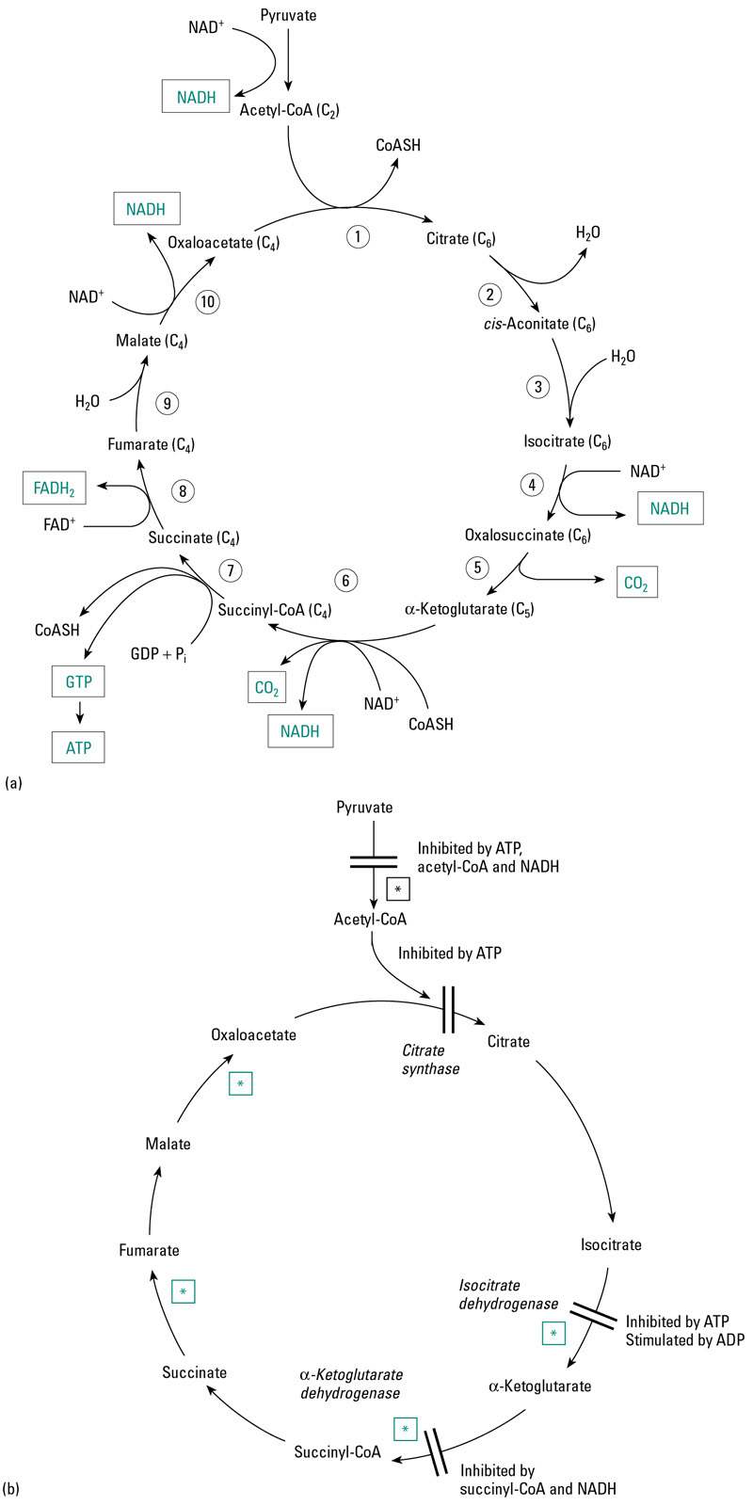
Fig 6.8a – The
Krebs Cycle showing
reducing equivalents
generated, ATP generated
and CO₂ produced

Slide 17
Pyruvate
dehydrogenase
complex
Fig 6.8b – The
Krebs Cycle showing
key control points

Slide 18
Entry of Substrates into Krebs Cycle
Carbohydrates = Glycolysis → Pyruvate → Acetyl CoA → to Krebs (pyruvate to acetyl-CoA is catalyzed by Pyruvate Dehydrogenase complex)
Lipids – stored lipids (triacylglycerol) mobilized by hormonally controlled triacylglycerol lipases
Yields 3 long-chain fatty acids + glycerol.
Glycerol is catabolized via glycolysis.
Fatty acids broken down 2-C per cycle in β-oxidation pathway and then enter Krebs Cycle via acetyl-CoA.

Slide 19
Entry of Substrates into Krebs Cycle
Also, peroxisomes may break down long-chain fatty acids to short- or medium-chain fatty acids, which are more readily metabolized.
β-oxidation occurs in mitochondrial matrix. FFA must first be transferred into mitochondrial matrix and activated by formation of fatty acyl-CoA.
Acyl-CoA Synthetase in OMM and ER catalyzes :
fatty acid + coenzyme A → fatty acyl-CoA (uses ATP)
To get across mitochondrial membranes, carnitine serves as a carrier (reaction catalyzed by fatty acyl-CoA carnitine transferase)
fatty-acyl coA + carnitine → fatty acyl carnitine + coA
Once in mitochondrial matrix, reconverted to fatty acyl-CoA by acyl-CoA synthetase.
fatty acyl carnitine → fatty acyl CoA + carnitine (uses GTP)

Slide 20
β-Oxidation
Rate limiting step in β-oxidation is apparently β-hydroxyacyl CoA dehydrogenase (at least in muscle), so increased β-HOAD activities allow increased flux of FFA as fuel.
NADH acts as an inhibitor
Another potentially rate-limiting step is the transfer of FFA to the mitochondrial matrix (includes Fatty Acid Binding Protein – intracellular transport, acyl carnitine transferase).
Also, movement of fat across cell membrane by fatty acid translocase and FABP_{pm} may limit fat catabolism capacity.

Slide 21
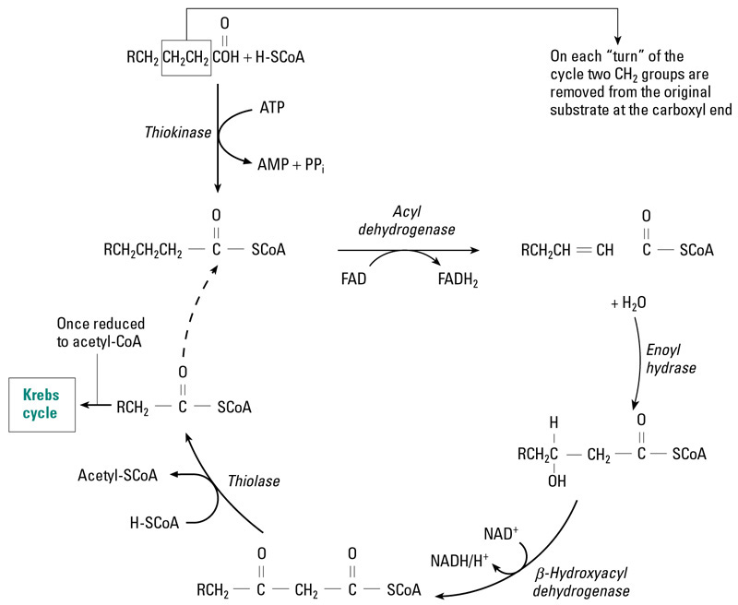
Fig 6.12 – The
Β-oxidation pathway

Slide 22
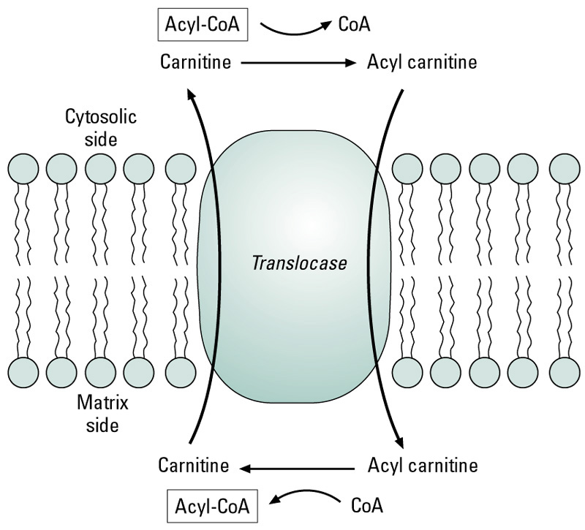
Fig 6.11 – Transfer
of fatty acids across
mito. membranes

Slide 23
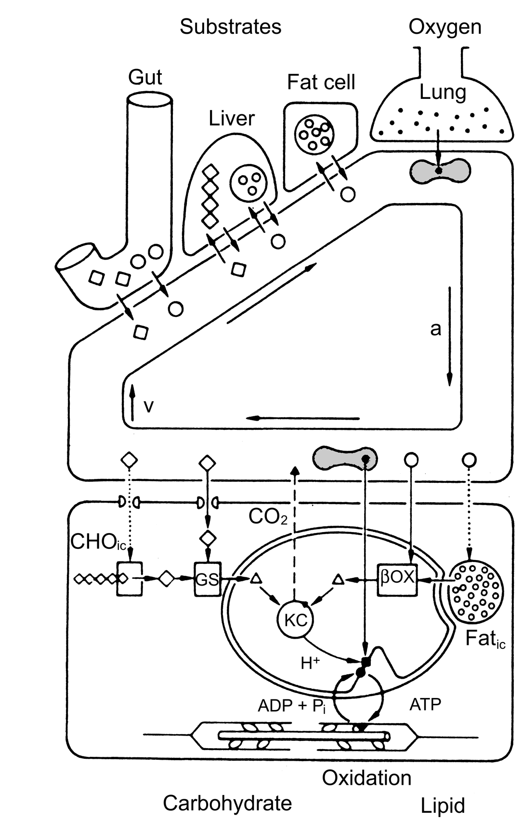
Fuel stores
Fuel sources
Fuel mobilization
& plasma transport
Trans-membrane transfer
PM = FA Translocase, FABP _{pm}
MM = Carnitine acyl trasferase
Fuel delivery
Intracellular lipid transfer: FABP_{C}
Fuel consumption
Cellular aerobic capacity
From Taylor et al. 1996

Slide 24
Entry of Substrates into Krebs Cycle
Proteins/Amino Acids = entry into Krebs Cycle involves two steps:
Removal of amino group – eventually excreted as nitrogenous waste
Conversion of carbon skeletons to pyruvate, acetyl-CoA, or other Krebs Cycle intermediates
Step 1 above is rate-limiting.
Efficiency of catabolism is lower than for carbohydrates and fats because nitrogenous waste removal incurs a cost.
ATP yields are approximately similar to those for carbohydrates.

Slide 25
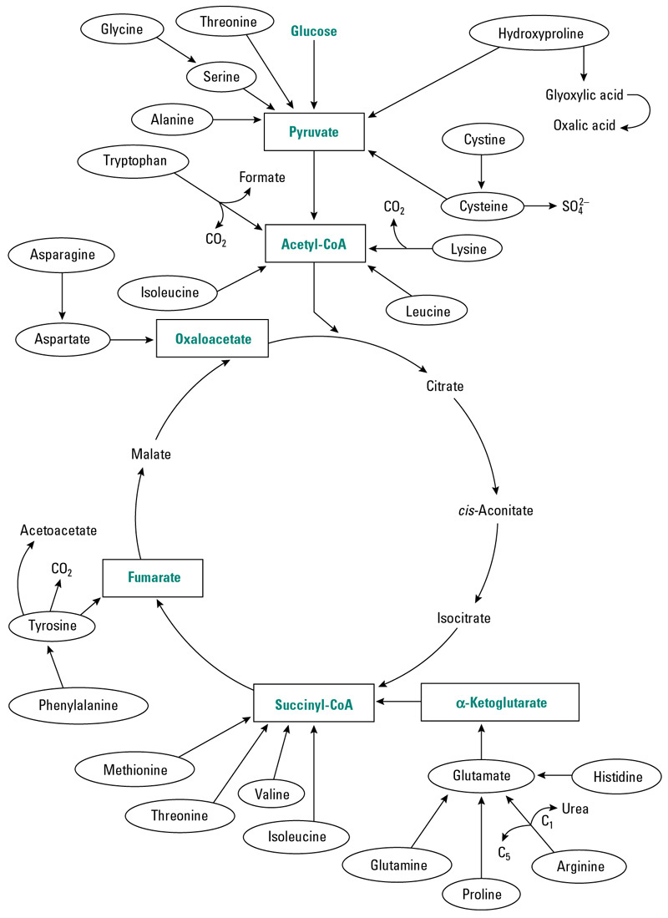
Fig 6.13 – Entry of amino
acids into the Krebs cycle
Note that different amino acids
enter as different Krebs cycle
intermediates.

Slide 26
Oxidative Phosphorylation (ETS of IMM)
NADH or FADH₂ from Krebs Cycle are fed through ETS with molecular oxygen serving as the final electron acceptor.
½ O₂ reacts with 2 protons to form water (“metabolic water”).
As electrons proceed down ETS, protons are released into the intermembrane space between IMM and OMM
This builds up proton and electric (charges differ on the two sides of the membrane) gradients across the IMM.
The energy stored in these gradients is then used to drive ATP synthesis.
As protons move down the gradient through a channel in the F₀-F₁ ATPase in IMM, energy is released that is coupled to the synthesis of ATP from ADP + P_{i}.
NAD⁺ and FAD⁺ are regenerated by the ETS.

Slide 27
Fig 6.9 – Electron carriers
and ATPase of ETS

Slide 28
Fig 6.9 – Arrangement of ETS enzymes on IMM

Slide 29
Reciprocal Regulation: Carbs and Lipids
Prolonged muscular activity (e.g., endurance exercise) results in the preferential use of fat relative to carbohydrates.
PFK inhibited by citrate and fatty acids, so cycling though the Krebs Cycle and β-oxidation inhibits glycolysis → increased reliance on fats as fuel.
Pyruvate Dehydrogenase is inhibited by acetyl-CoA. This also inhibits carbohydrate catabolism with prolonged muscular activity.
Since glycolysis is inhibited, Glucose-6-phosphate levels increase and G-6-P inhibits glycogen phosphorylase and hexokinase, thereby sparing muscle glycogen and blood glucose. Depletion of muscle glycogen is correlated with fatigue in mammals.

Slide 30
Reciprocal Regulation: Carbs and Lipids
Gluconeogenesis in liver from amino acids and pyruvate is promoted by β-oxidation → acetyl-CoA, which stimulates pyruvate carboxykinase, which catalyzes:
This keeps blood glucose supply essentially constant during prolonged exercise and this is important since glucose is required for proper functioning of the brain (can’t use fat as fuel).
Pyruvate carboxylase PEP carboxykinase
Pyruvate → Oxaloacetate → PEP → Glucose

