Slide 1
Respiratory System
Forms as an outpocketing from the pharynx region of the digestive tract
Embryonically, all vertebrates possess a series of paired outgrowths of the gut tube projecting laterally to meet the ectoderm of the body wall.
These outgrowths are termed pharyngeal pouches, and the corresponding ectodermal invaginations of the body wall are termed pharyngeal grooves.
Together, a pouch plus a groove make up a pharyngeal gill slit.
Mesoderm is restricted to columns between the pouches = pharyngeal (branchial) arches.

Slide 2
Pharynx
In most primitive vertebrates, the number of gill slits is higher (6-14) than in more advanced vertebrates (3).
Evolutionary trend = reduction in number of gill slits in more advanced vertebrates.
Primitively, the pharynx was used in filter-feeding (e.g., Amphioxus)
Structurallly, the pharynx forms from only a short tube connecting the mouth with the esophagus; but the pharyngeal derivatives form the respiratory system (gills and lungs) and certain glands.

Slide 3
Pharynx
Pharynx is shared between digestive and respiratory tracts.
Fate of pharyngeal arches in jawed fishes and tetrapods:
The first branchial arch (mandibular) forms the jaws
The second arch (hyoid) functions in jaw support, support of respiratory tubes, sound transmission, and respiration (gills)
The remainder of the arches form gills (in fish) or derivatives (in tetrapods)

Slide 4
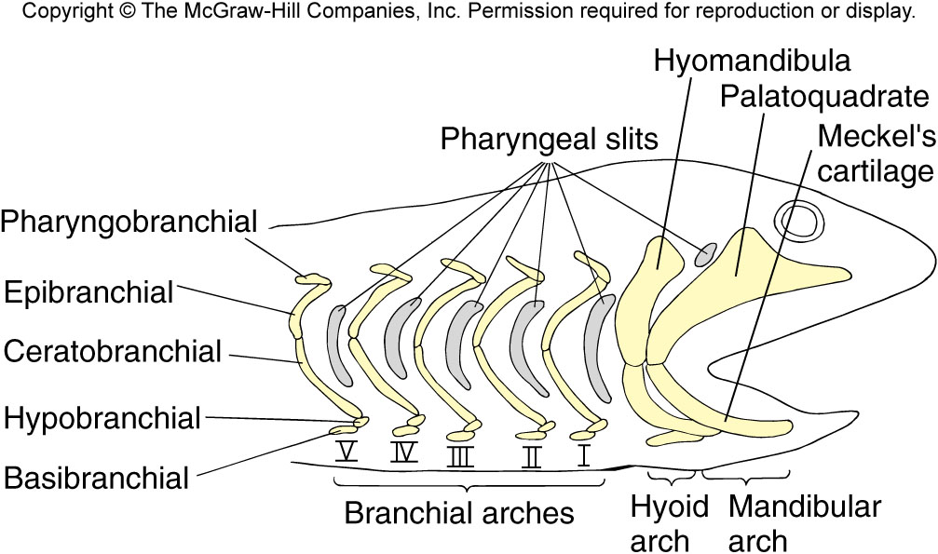
Fig 7.5 – Fates of branchial arches in gill-breathing vertebrates

Slide 5
Gills
Develop from branchial arches plus ectodermal and endodermal lining of the arches.
Mesoderm contributes to the skeletal and muscular components (gill arches).
The epithelial lining of the arches becomes folded as filaments; lamellae form as folds in the lining of the filaments.
Gas exchange occurs between water and capillaries in the gill lamellae in a countercurrent arrangement.
This is the most efficient arrangement for gas transfer.

Slide 6
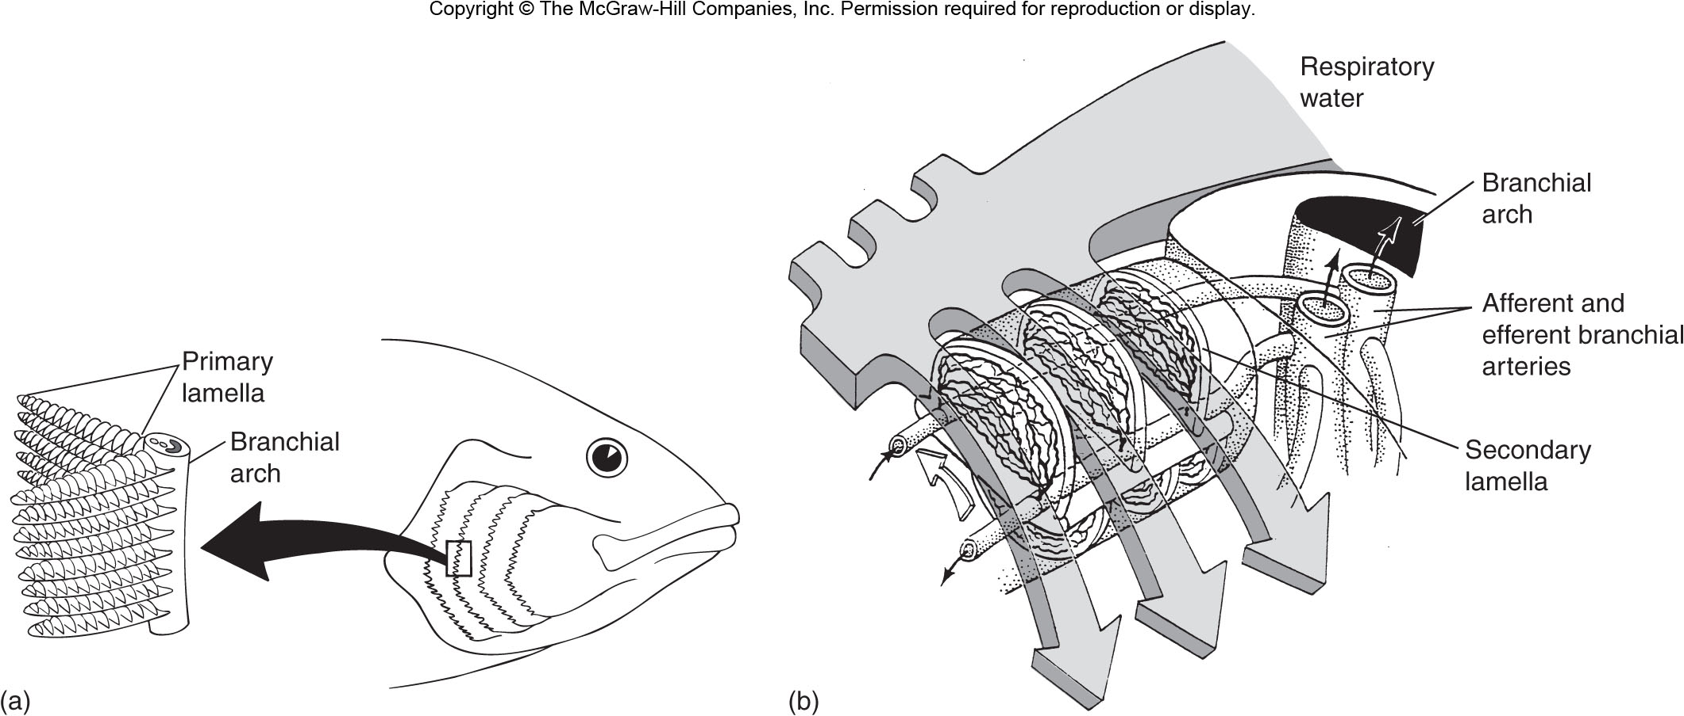
Fig 11.19 – Gill ventilation and gas exchange in teleost fish

Slide 7
ANATOMY of GILLS IN ELASMOBRANCHS (primitive) AND TELEOSTS (advanced)
(Chondrichthyes vs. Osteichthyes)
Elasmobranchs | Teleosts
Gill septum extends to surface | Gill septum reduced to base of filaments
Gill slits open individually to surface exit | Gill slits open to common chamber (opercular chamber) with single opening to exterior
Spiracle present = slit between mandibular (1) and hyoid (2) arches | Spiracle absent

Slide 8
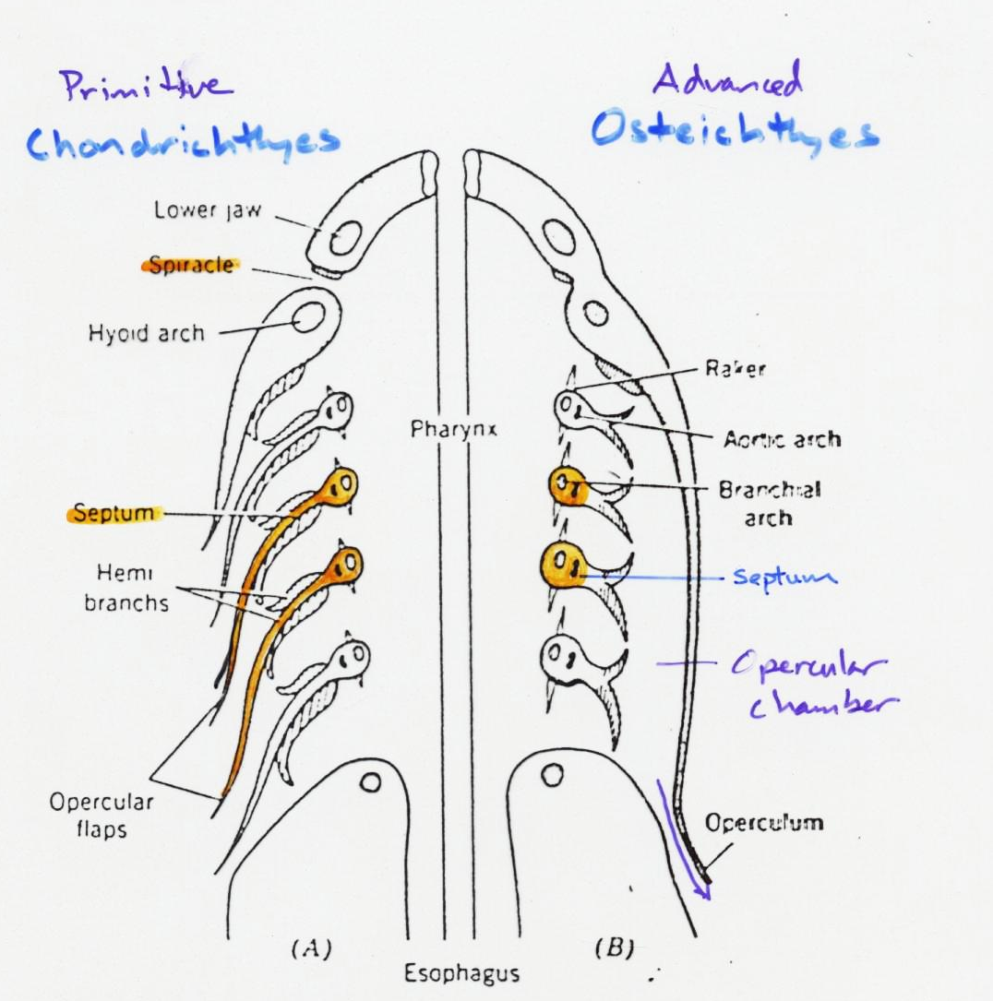

Slide 9
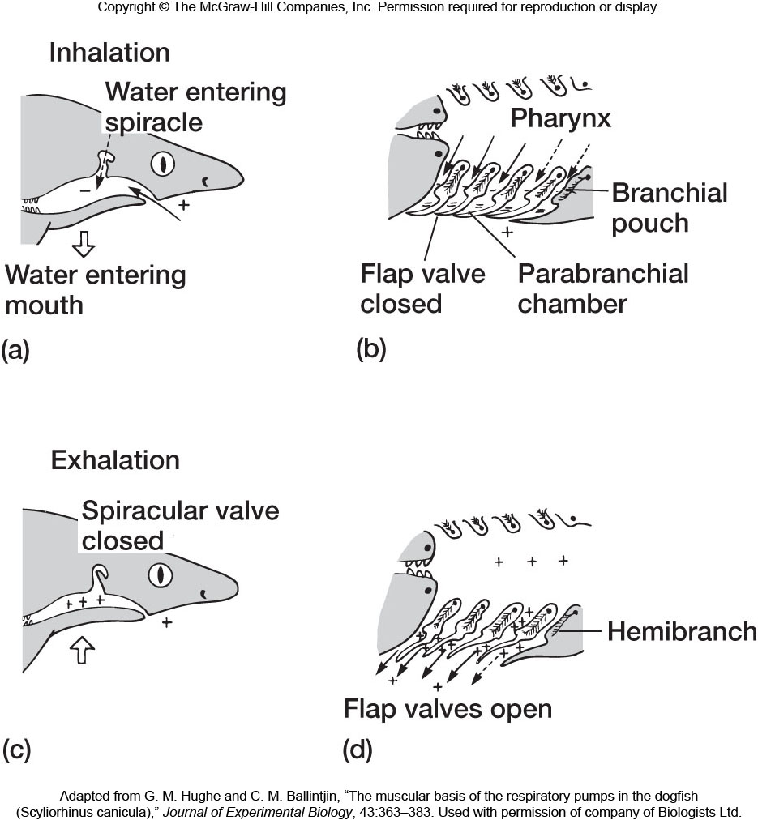
Fig 11.18 – Gill ventilation and gas exchange in a shark

Slide 10
External Gills
Outgrowths of epithelium covering gill arches 3-5 in extant vertebrates
Occur in larval lungfish, amphibians, and some adult aquatic amphibians
Gas exchange is facilitated by muscles located at the gill base acting to wave the gills through the water, thereby creating currents to move new oxygen-rich water over the gill surface.

Slide 11
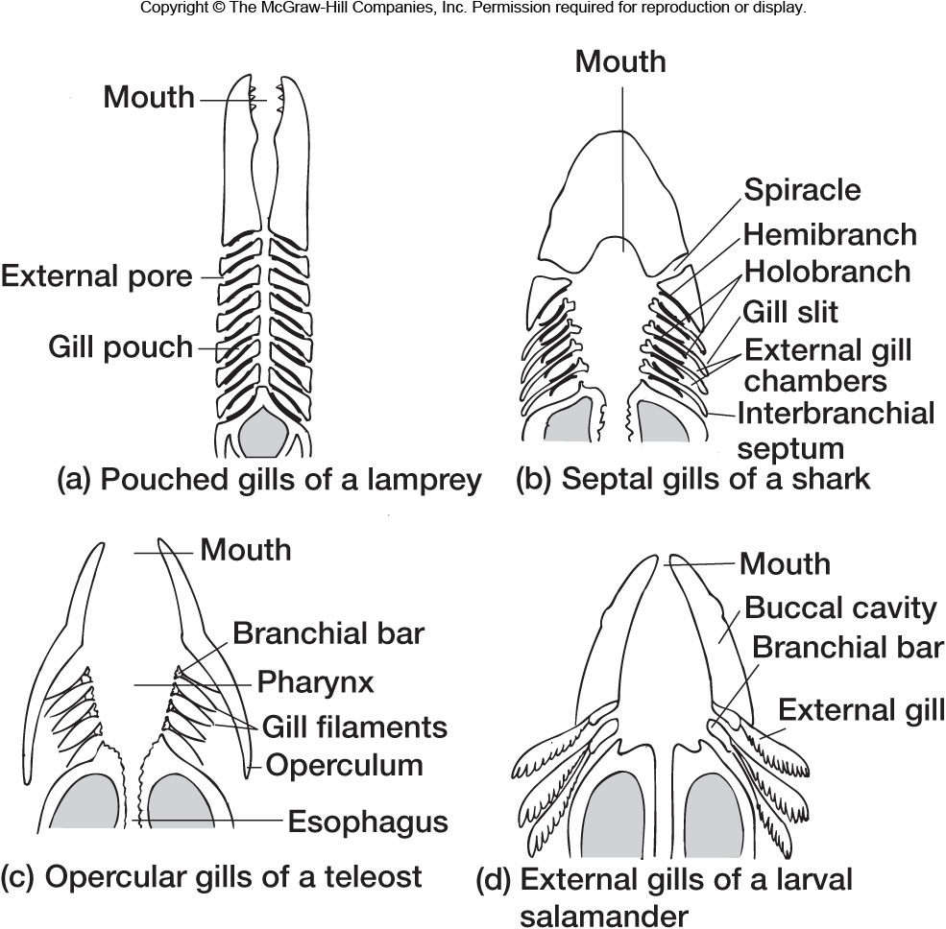
Fig 11.4 – Gill coverings in vertebrate animals

Slide 12
Lungs and Swim Bladders
Embryonic Origin
Lungs = ventral outpocketing from floor of pharynx
Swim Bladder = dorsal outgrowth from pharynx
Phylogenetic Origin
Lungs are characteristically associated with Tetrapods, but they are more primitive.
Lungs are present in:
Dipnoans (Lungfishes)
Polypterus (bichir) = most primitive living Actinopterygian
Evidence for lung-like structures in a Devonian placoderm – suggests that lungs are a very ancient structure.

Slide 13
Lung Evolution
It is likely that some ancient fishes used a vascularized mouth and pharynx for accessory air breathing (to supplement gill-breathing, as in some modern fishes and amphibians).
Any outgrowth of the pharynx would increase surface area for respiration and would presumably be advantageous.
A continuation of this trend would then result, eventually, in the formation of lungs.

Slide 14
Swim Bladder
Consists of elongate sac arising as a dorsal outgrowth from the pharynx
Present in most Actinopterygians
Major Function = hydrostatic organ (accessory respiration function in Holosteans)
Polypterus (bichir) has no swim bladder, but has paired ventral lungs
Thus, it appears that the swim bladder appeared early in the history of the Actinopterygians by the lungs becoming singular and assuming a dorsal position
The only intermediate condition is in Erythrinus (a Teleost) which shows a lateral attachment of the swim bladder to the gut

Slide 15
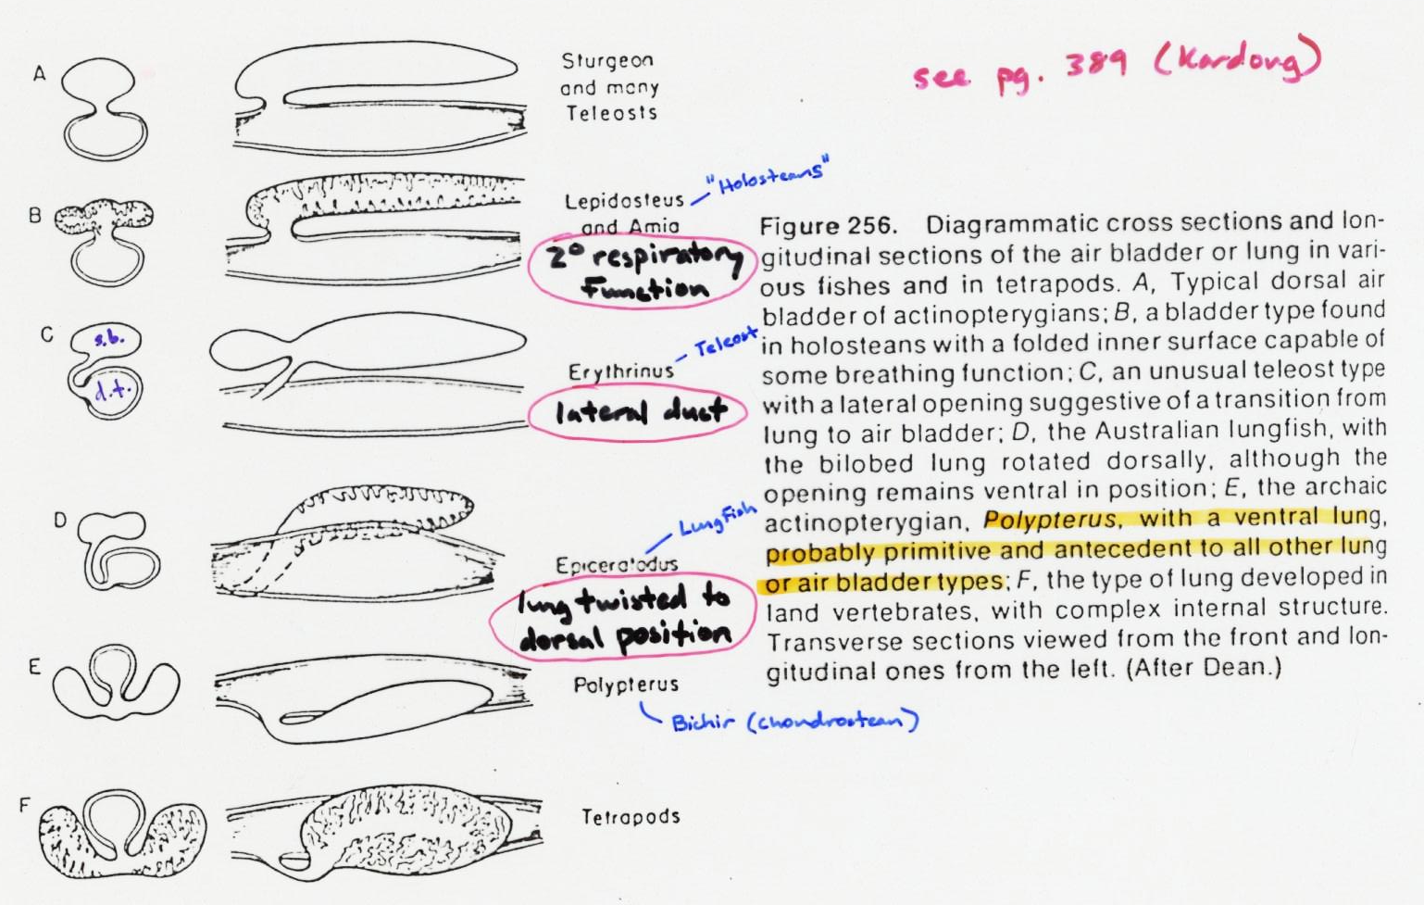

Slide 16
Swim Bladder Conditions
Physostomous = swim bladder retains an open connection to the digestive tube (= pneumatic duct)
Most Primitive = Chondrosteans, “Holosteans”; Pneumatic duct is short and broad, connects to back of pharynx
Primitive Teleosts have a narrow elongate pneumatic duct opening to the digestive tract at the esophagus or more posteriorly (Salmonids, etc.)
Physoclistous = connection with digestive tube is lost entirely
Swim bladder fills with gas by a complicated countercurrent gas exchange system
Occurs in advanced teleosts

Slide 17
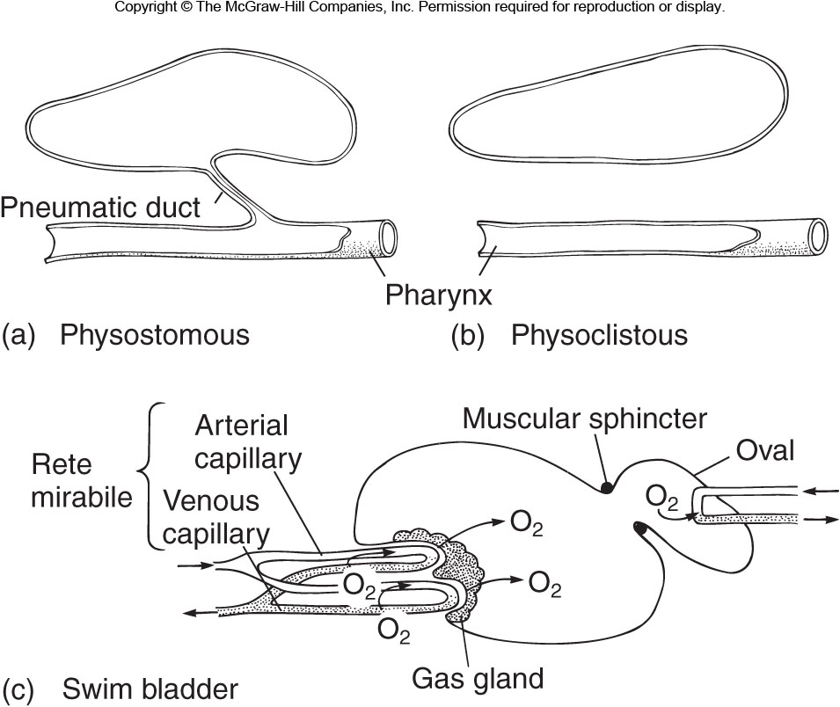
Fig 11.22 – Swim bladders

Slide 18
Mammal Lungs
Air passages branch to form tree-like structures
Passages terminate in thin-walled sacs (alveoli) where gas exchange occurs
Flow is bidirectional (inspiration and expiration occur over the same passageways).
Lungs are relatively large, reside in pleural cavity separated from coelomic cavity by diaphragm
Mammals = only vertebrates with a diaphragm

Slide 19
Mammal Lungs
Breathing is accomplished by a negative pressure system.
Outward movement of ribs + downward movement of diaphragm expands lung cavity → creates a partial vacuum → air rushes in to equilibrate pressure

Slide 20
Fish Lungs
Lungs are simple sacs with few internal folds (Polypterus - low surface area) or a minor degree of subdivision (Lungfish)
Lungfish lungs are dorsal, but the duct arrangement suggests this is a secondary condition because it opens to the ventral pharynx
Bidirectional flow as in mammals

Slide 21
Amphibian/Reptile Lungs
Amphibians similar to lungfish condition – some supplementary respiratory surface provided by ridges and septa in epithelial lining
Reptiles show a modest internal subdivision
Bidirectional air flow.
Amphibians (and fish) = lungs filled by buccal pump (positive pressure) → swallowing air
Reptiles = lungs filled by suction pump system similar to mammals, but not as efficient since no diaphragm is present

Slide 22
Bird Lungs
Complicated air sac system (no gas exchange in air sacs) allows unidirectional (1-way) flow over lungs
Gas exchange occurs in air capillaries that open to a tube (parabronchus) through which air flows in only one direction
Blood flow in avian lung is via a crosscurrent mechanism relative to air flow
This functions similar to a countercurrent system, and is more efficient for oxygenating blood than the bidirectional flow system of other Tetrapods
This explains their success at high altitudes relative to mammals

Slide 23
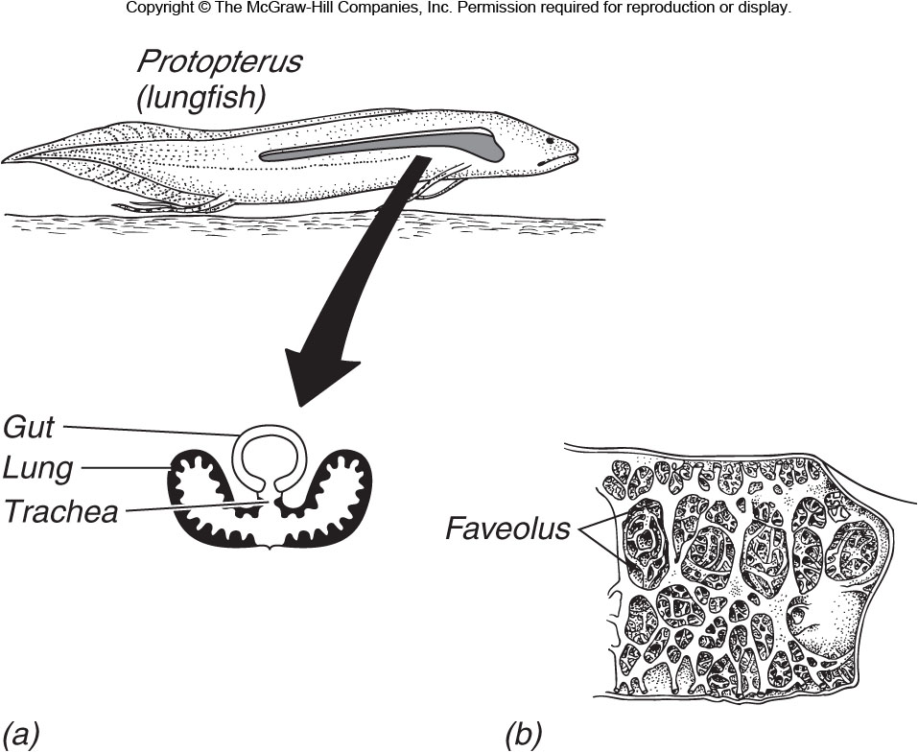
Fig 11.21 – Fish lungs

Slide 24
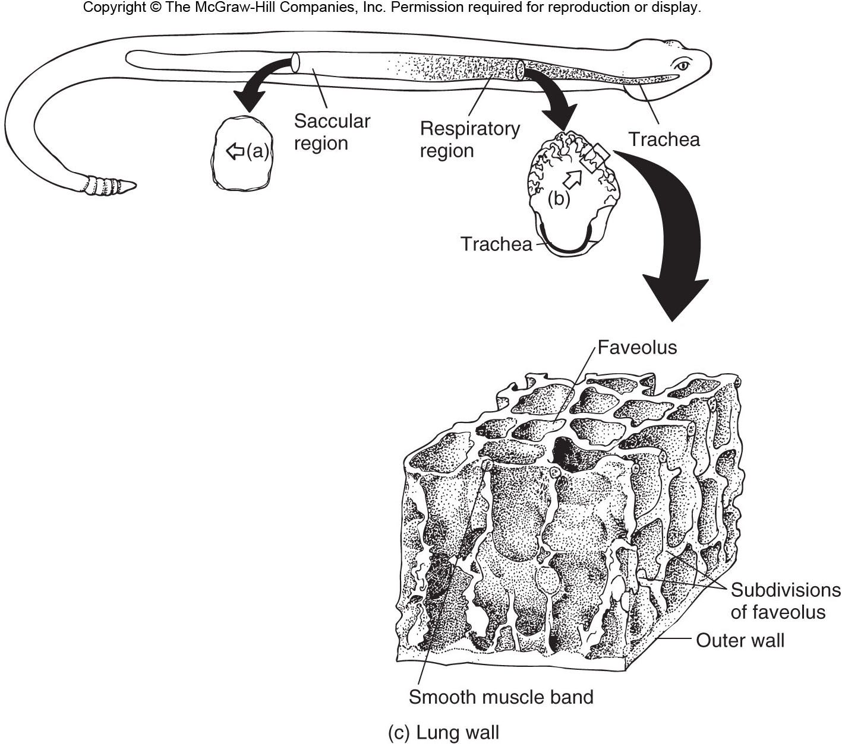
Fig 11.27 – Reptile lungs

Slide 25
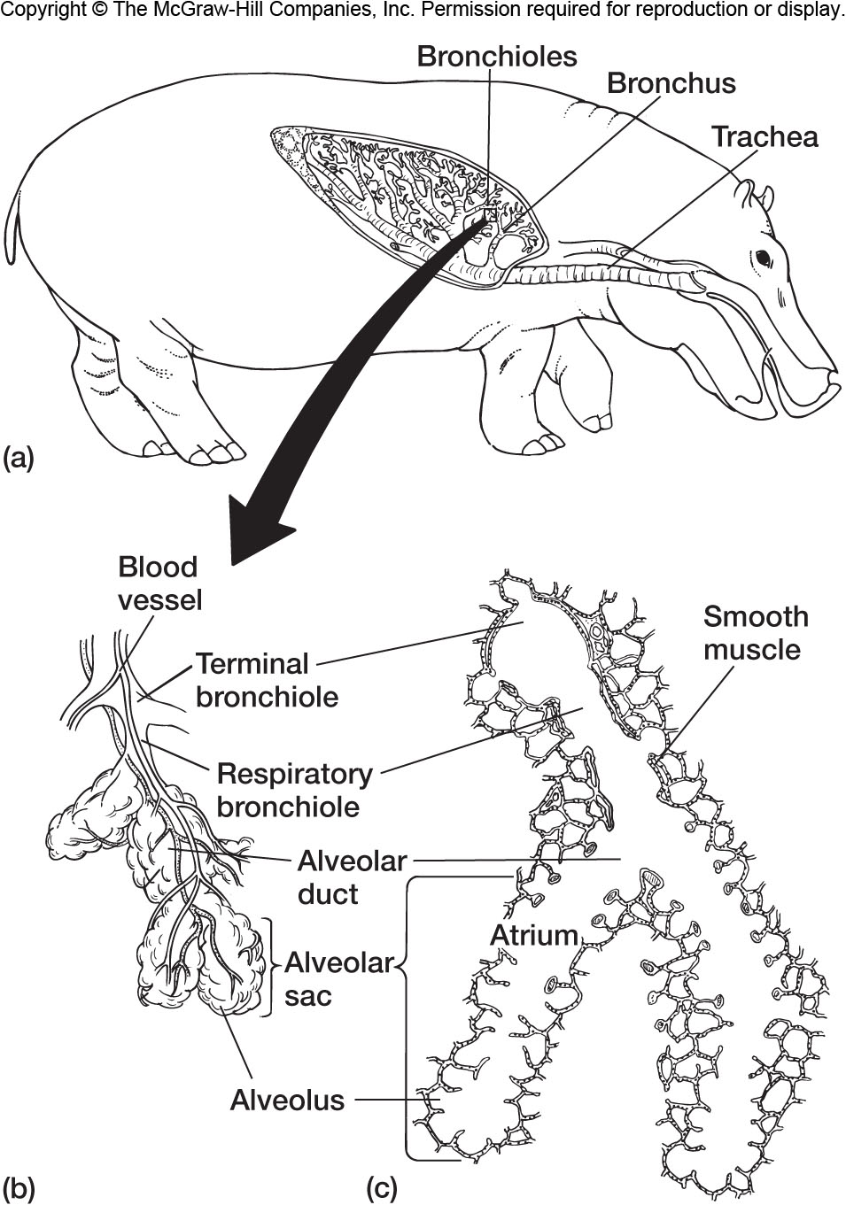
Fig 11.34 – Mammalian lung

Slide 26
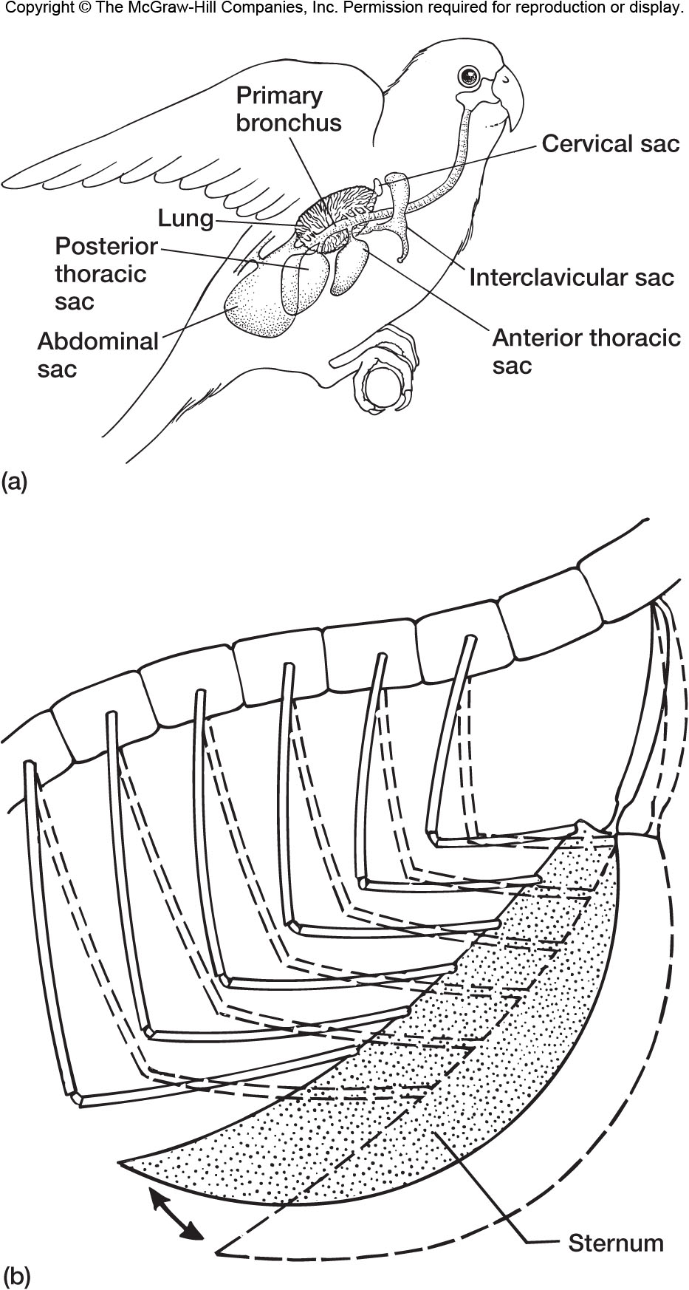
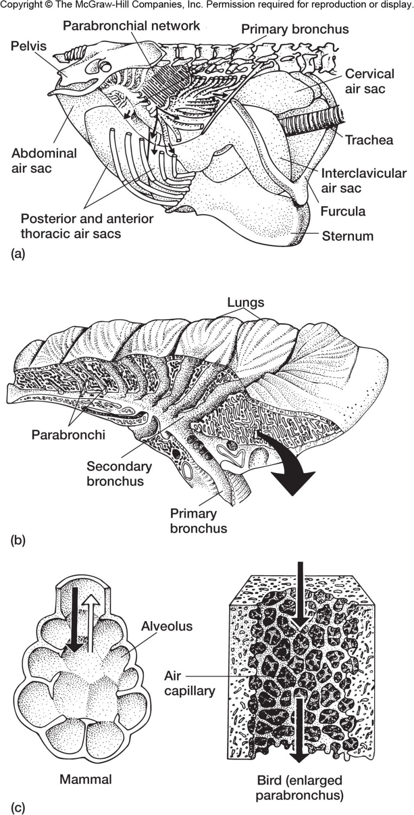
Figs 11.35 & 36 – Bird respiratory system

Slide 27
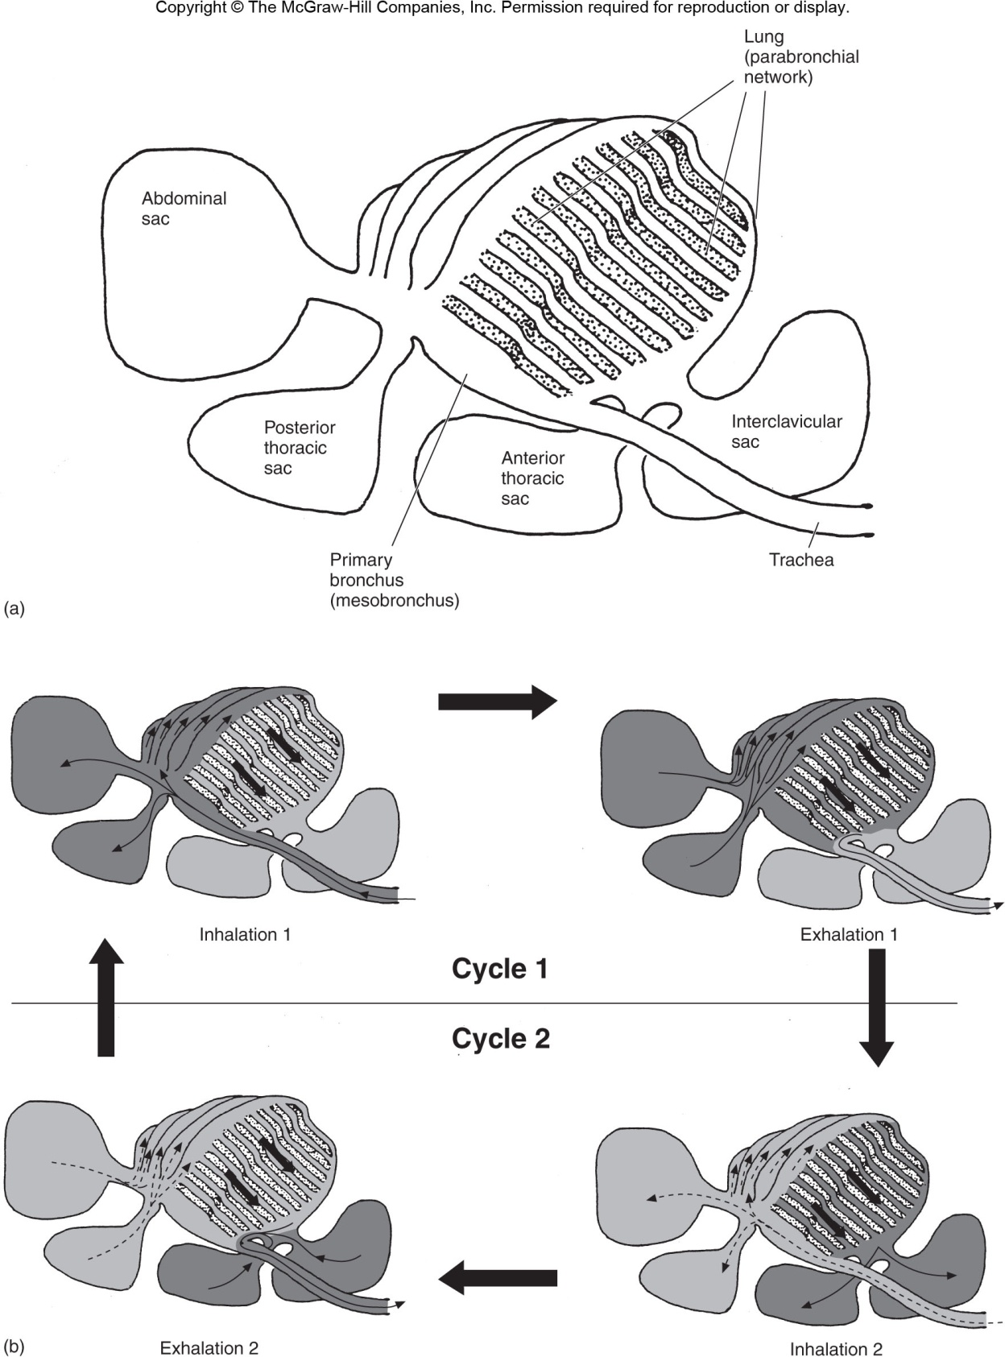
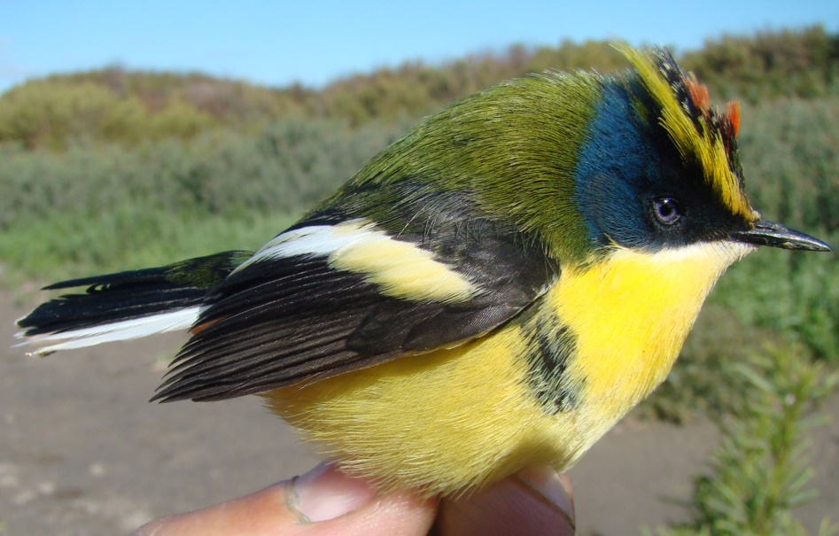
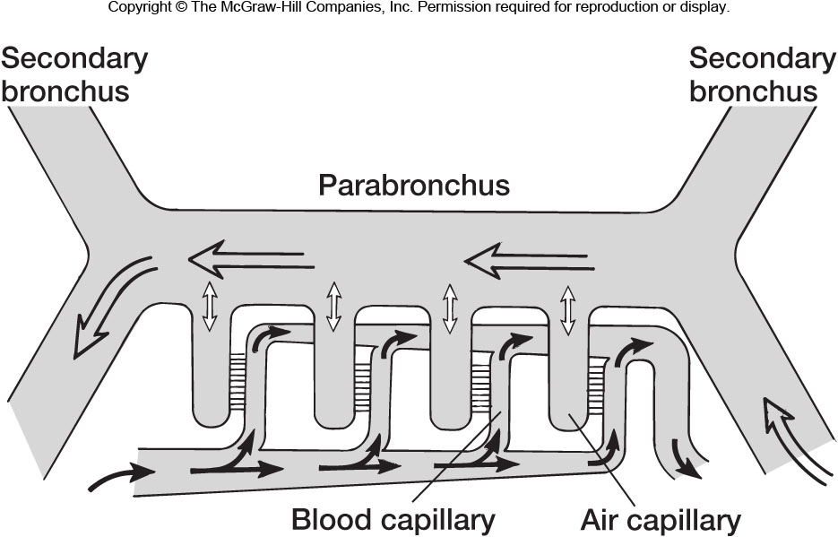
Figs 11.37 & 38 – Bird respiratory system

