Slide 1
Reproductive System
Consists of gonads (testes or ovaries) + system of ducts + external genitalia (if present)
Gonads originate from thickening of splanchnic mesoderm just medial to embryonic kidney
Region of splanchnic mesoderm = genital ridge
Primitive condition of genital ridge was elongate (anterior to posterior orientation)

Slide 2
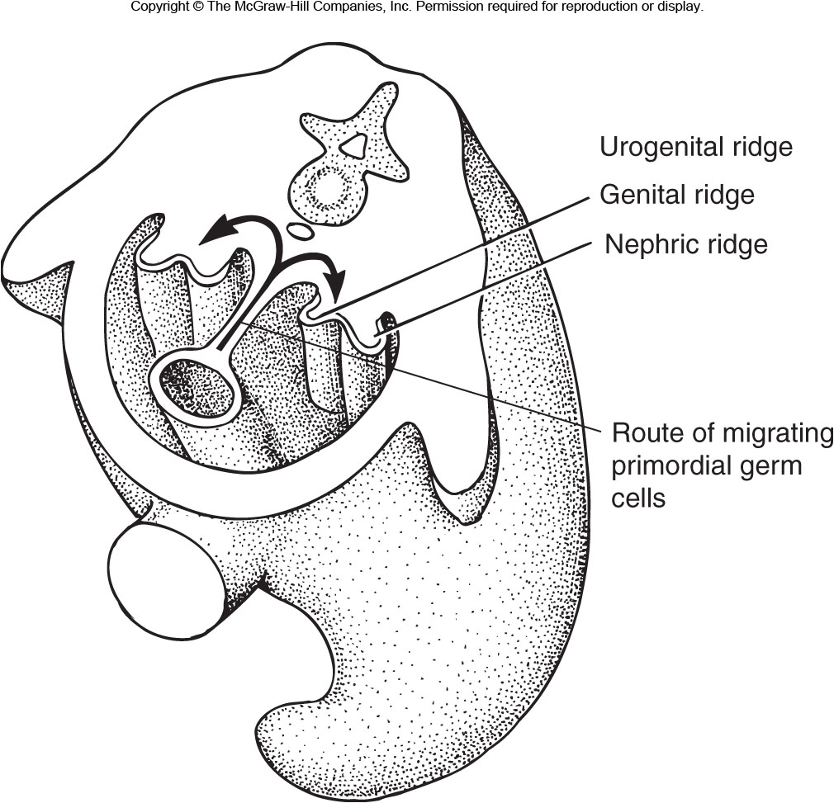
Figure 14.18

Slide 3
Gonad Development
Genital ridge (gonad) early on forms 3-layered structure:
Outermost layer = germinal epithelium (cortex)
Middle layer = tunica albuginea (composed of CT)
Innermost layer = primary sex cords (medulla)
Primordial germ cells (from extraembryonic endoderm) present in both cortex and medulla
At this stage, gonad has potential to develop as either male or female gonad (Indifferent Stage)

Slide 4
Gonad Development
Eventually, a sexual stage follows the indifferent stage, where the gonad is locked into a fate as either ovary or testis.
In sexual stage, only ducts and accessory structures of one sex will continue development
Non-pertinent structures of the opposite sex will cease development and in some cases regress. In other cases, development stops but rudiments persist in adults.

Slide 5
Male Gonad Development
Primary sex cords (medulla) hollow out to form seminiferous tubules.
Lined by germinal epithelium in which primordial germ cells reside
Cortex regresses to mesothelium
Tunica albuginea becomes vascularized
Tissue lying between primary sex cords develops into interstitial tissue containing Leydig cells (secrete testosterone)

Slide 6
Female Gonad Development
Germinal epithelium (cortex) thickens as secondary sex cords
Primordial germ cells lie between cords and become surrounded by cells from the cords to form ovarian follicles
Medulla largely degenerates
Tunica albuginea largely degenerates

Slide 7
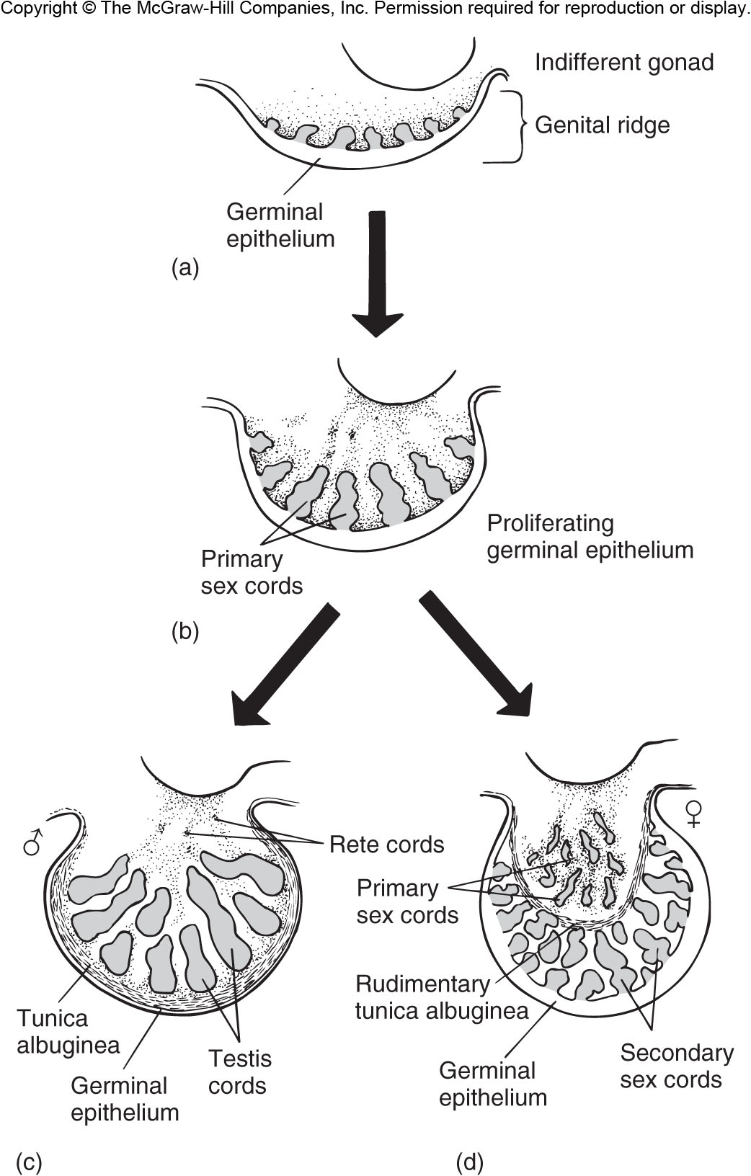
Figure 14.19

Slide 8
Gonad Development Summary
Bipotential early on – can develop into gonad for either gender
Male: medulla predominates, cortex regresses
Female: Cortex predominates, medulla regresses
Differentiation depends on the environment of development (e.g., temperature, hormones)

Slide 9
Gonad Development Summary
Gonad development experiments …
If transplant germ cells from the gonad of one gender to the other → germ cells differentiate according to the gonad to which they were transplanted
Elimination of one component may cause differentiation of the other:
Toads – adult males retain portions of cortex. If testes removed cortex develops into ovaries capable of producing fertile eggs.
Chickens – Only left ovary forms functional ovary, right is rudimentary (consists of undifferentiated medulla tissue). If left ovary removed, rudimentary right ovary forms testis.

Slide 10
Location of Gonads Within Body
Ovaries occur within body cavity of female vertebrates
Egg development proceeds at body temperature
Testis occur within abdomen of most vertebrates (including monotremes and a few placental mammals)
Testis temperature equivalent to body temperature, so sperm development occurs at body temperature

Slide 11
Location of Gonads Within Body
Testis housed outside of abdominal cavity in scrotal sac in most mammals
May represent coelomic pouch (most mammals) or muscular sac (moles, shrews, many rodents, lagomorphs, pinnipeds, hyenas)
Coelomic pouch condition → During development, testis descend from abdominal cavity through inguinal canal into scrotal sac
Allows 2-4°C lower temperature, which is important for sperm viability
Why the lower temperature requirements for sperm development have evolved in mammals is not known

Slide 12
Reproductive Tract Development
Parts of the embryonic excretory tract are co-opted or shared with the reproductive tract
Variation occurs among vertebrates and between sexes as to which excretory ducts become associated with reproductive tracts
Mullerian duct arises next to archinephric duct
Developing reproductive system early on has both male and female genital ducts in all jawed vertebrates

Slide 13
Reproductive Tract Development
Females: archinephric duct (initially drains opistonephros) functions within excretory system; Mullerian duct forms oviduct
Males: Archinephric duct becomes vas deferens; Mullerian duct regresses, if it develops at all
Male: Elasmobranchs
and Amphibians
Female: Elasmobranchs
and Amphibians
Male: Amniotes
Female: Amniotes

Slide 14
Male: Elasmobranchs
and Amphibians
Female: Elasmobranchs
and Amphibians
Male: Amniotes
Female: Amniotes
Genital duct derivation in different vertebrates

Slide 15
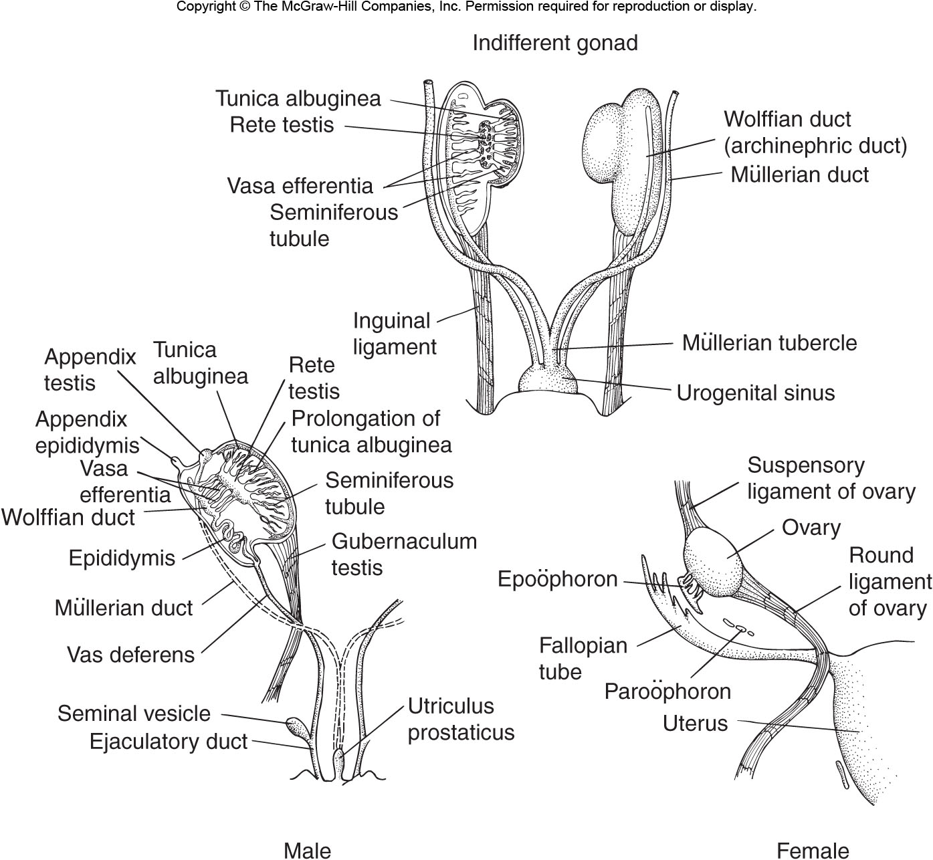
Fig 14.20 – Embryonic formation of male and female genital systems in mammals

Slide 16
Adult Genital Ducts
Cyclostomes: no specialized ducts present in either males or females
Gametes shed directly into coelom → proceed to genital pores (abdominal pores), which open exteriorly at posterior end of coelom
Gnathostomes: Males and females differ
Males = sperm conducted to exterior via system of closed ducts
Pronephric and mesonephric sections of archinephric duct contribute to pathway (except in teleosts)

Slide 17
Adult Genital Ducts
Gnathostomes: Males and females differ
Females = eggs in most cases shed to coelom, but guided by funnel-like opening to oviduct (ostium or infundibulum) located near ovary
Archinephric duct maintains excretory system function
Mullerian duct becomes oviduct and conveys ova to uterus

Slide 18
Oviduct and Derivatives
In almost all cases (exception = teleosts) oviduct opens to coelom near ovary and empties into cloaca
Teleosts = ovary folded so that it encloses a special coelomic pocket into which ova are shed
Ova travel from pocket down duct formed by peritoneal folds (not homologous to oviduct of other vertebrates) which leads to exterior
No eggs shed to coelom
Adaptive because massive number of eggs released would overflow conventional ostium and escape into coelom → useless for reproduction

Slide 19
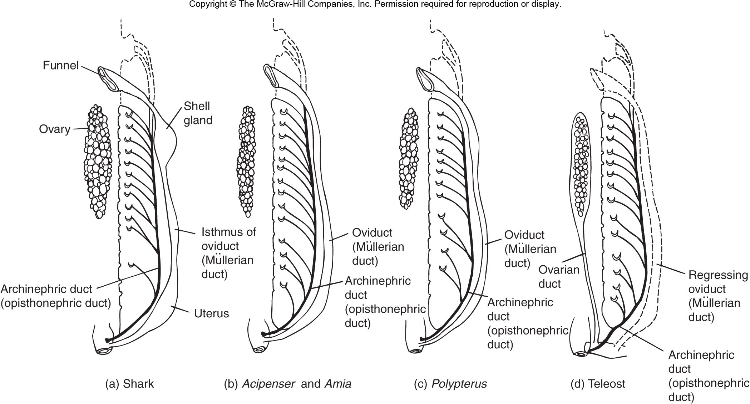
Fig 14.24 – Oviducts of female fishes. Note that all fishes except teleosts maintain typical vertebrate condition with Mullerian duct forming oviduct. Most teleosts have an ovarian duct that forms from peritoneal folds and exits the body at the cloaca.

Slide 20
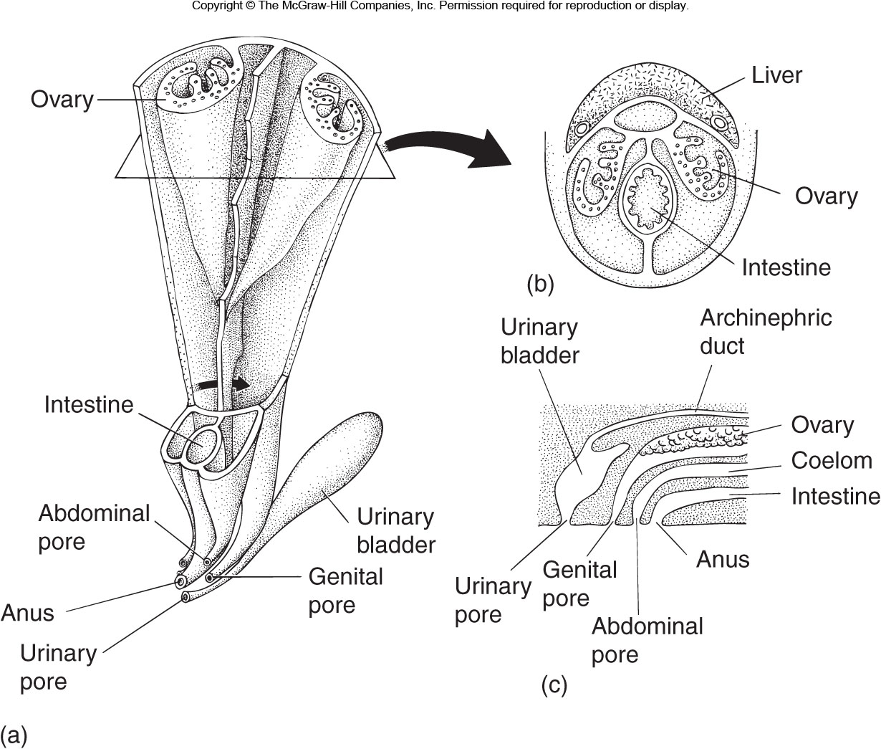
Fig 14.26 – Teleost reproductive system. Note how the ovary is enclosed within peritoneal folds that from a new ovarian duct.

Slide 21
Specialized Regions of Oviduct
Glands:
Albumen Gland = secretes albumen (egg white protein)
Jelly Gland = secretes jelly-like coating enclosing amphibian egg masses
Shell Gland = present in Elasmobranchs, Reptiles, Birds and Monotremes; secretes the shell surrounding the egg and enclosing the egg contents
Regions for Embryonic Development = uterus in placental mammals, specialized regions in other viviparous vertebrates.

Slide 22
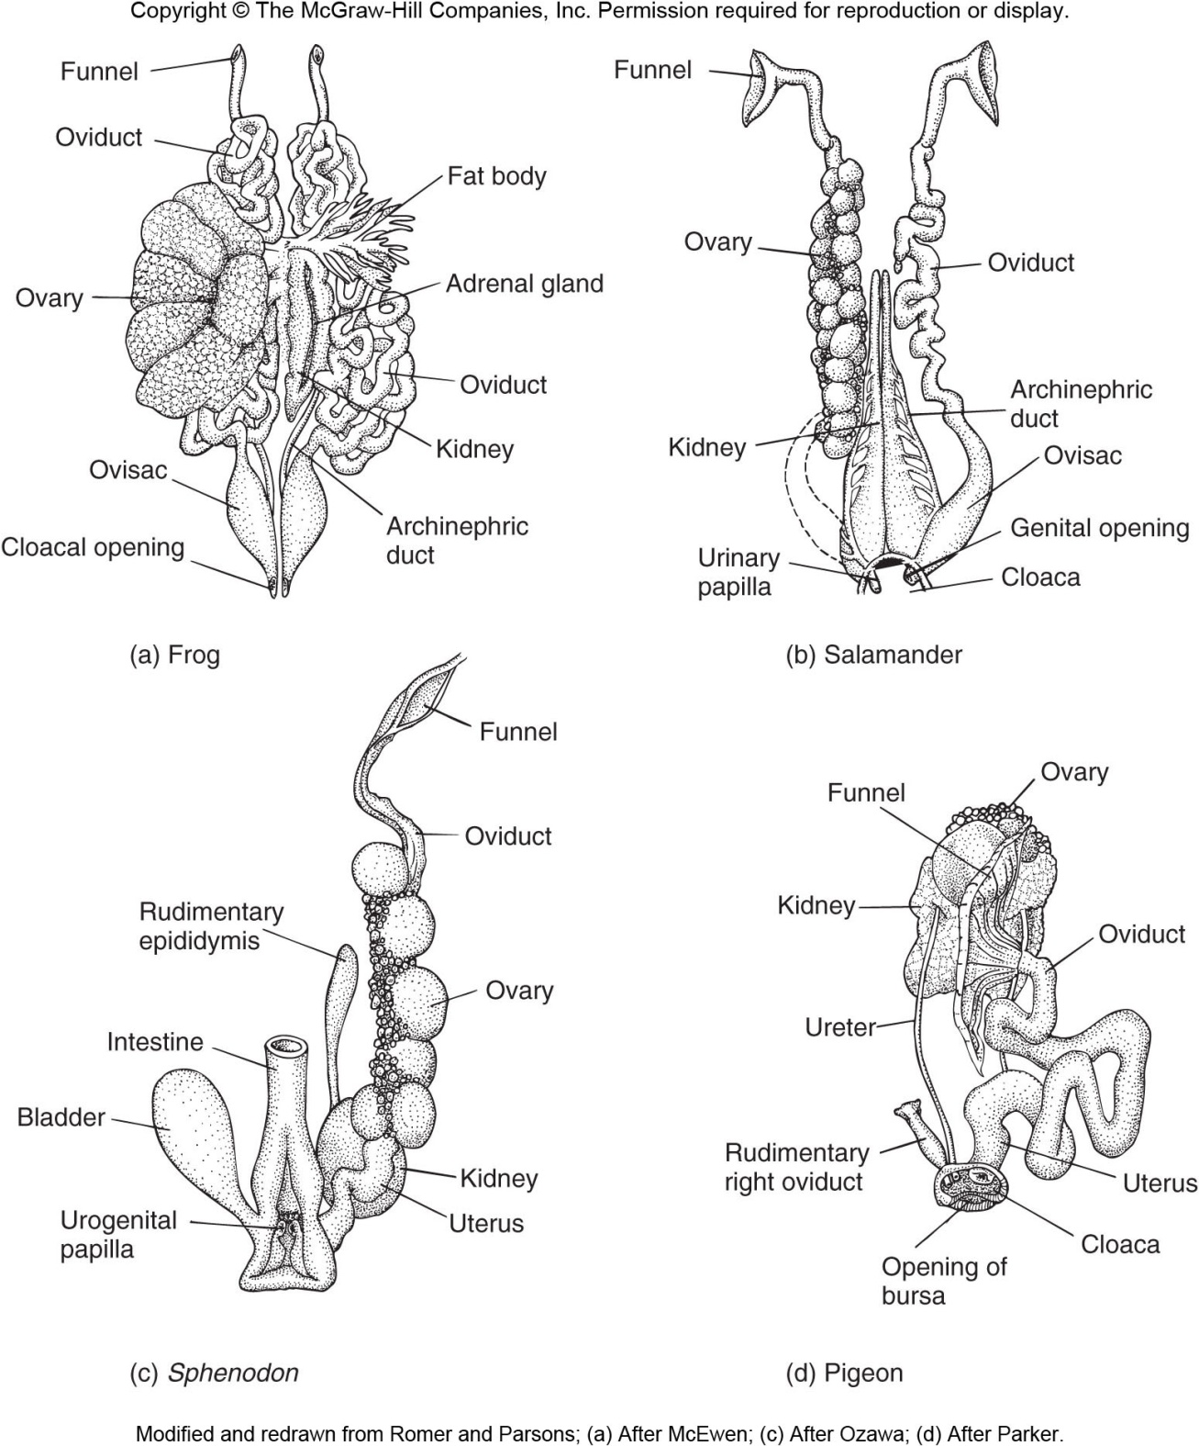
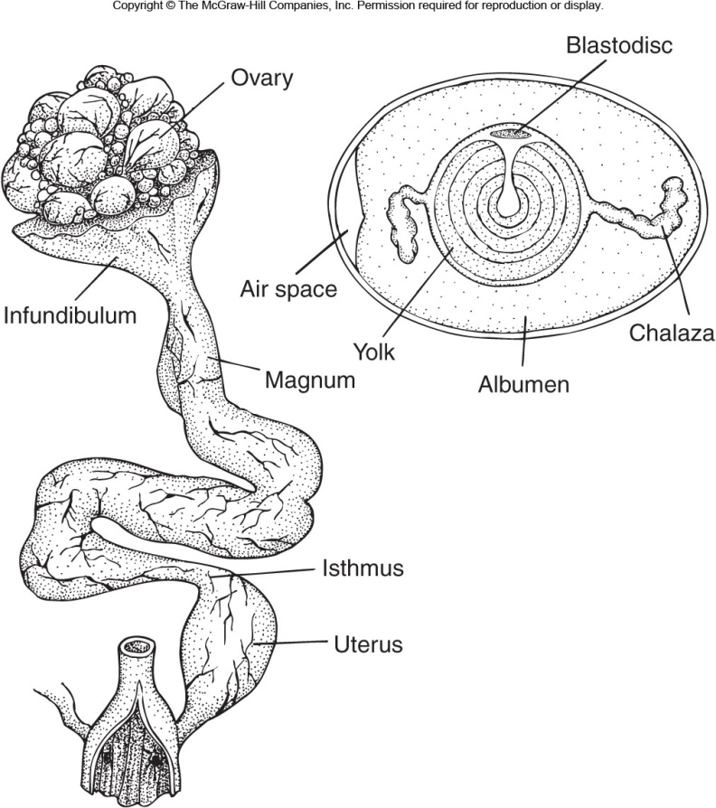
Fig 14.28 – Urogenital systems of female Tetrapods
(Adds albumen)
(Adds shell membranes)
(Adds shell)
Chicken

Slide 23
Specialized Conditions of Oviduct
Some Elasmobranchs show fused ostia (funnel-like opening to oviduct near ovary)
Birds – right oviduct and ovary usually degenerate as an adaptation to reduce weight for flight
Mammals – fusion of lower regions into uterus (in advanced forms) and vagina

Slide 24
Uterine Types in Mammals
Primitive Condition = separate
Advanced Condition = fused into a single structure
Duplex = uteri separate (marsupials, bats, many rodents)
Bipartite = some rodents
Bicornuate = carnivores
Simplex = primates

Slide 25
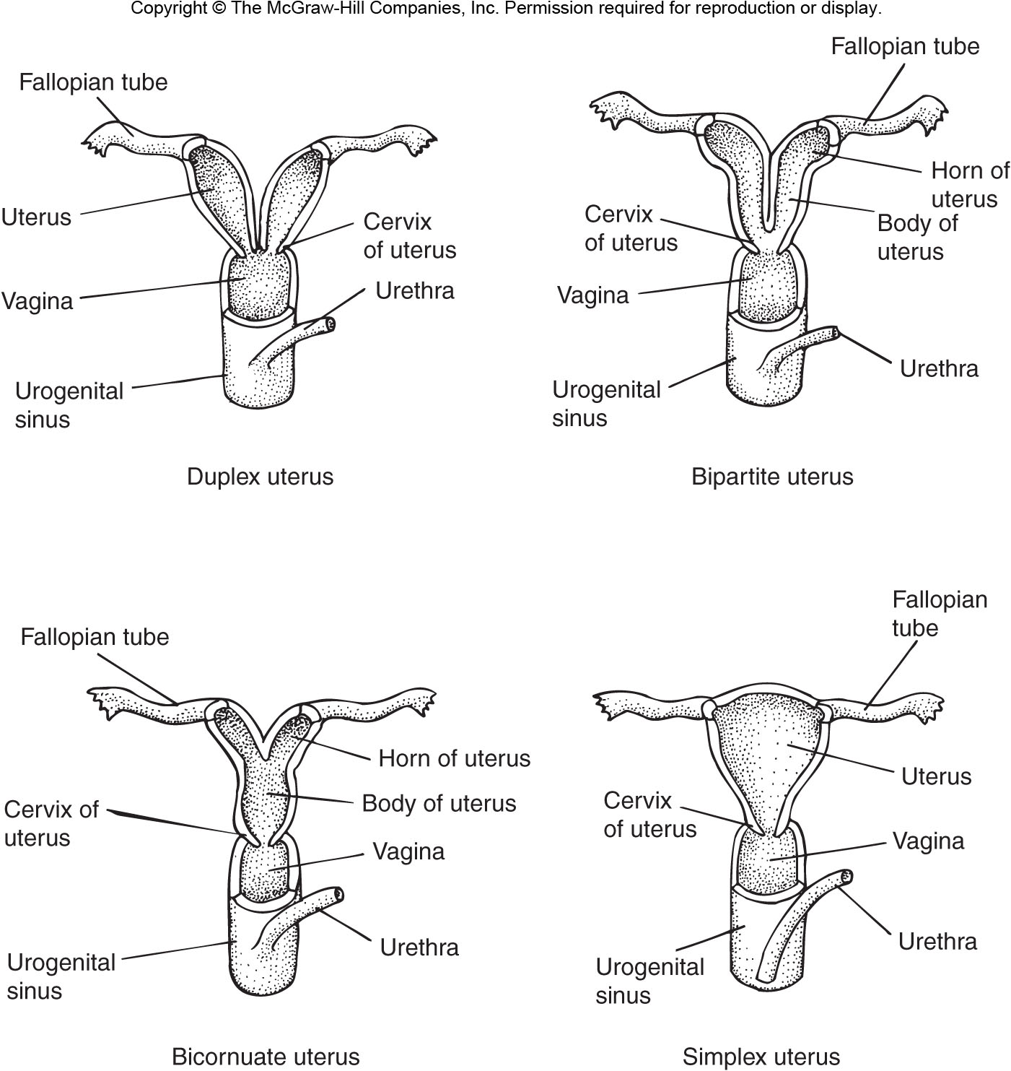
Fig 14.52 - Uterine Types in Mammals

Slide 26
Male Genital Duct System
Cyclostome Condition = large unpaired testes have no genital ducts
Sperm are shed to coelom and exit via abdominal pores
Archinephric ducts serve purely excretory function
Primitive Condition = seminiferous tubules lead to tubules of rete testis, which become continuous with archinephric duct – serves both urinary and reproductive functions
Occurs in primitive Actinopterygians, lungfish, some amphibians

Slide 27
Male Genital Duct System
Most Osteichthyes = archinephric duct with solely urinary function
Sperm travel via new tube (sperm duct) probably derived from central canal of testis
Sperm duct empties to external opening behind anus
In all other vertebrates, archinephric duct taken over to varying degrees to serve reproductive function

Slide 28
Male Genital Duct System
Chondrichthyes and Amphibians = urine transport only in posterior portion of archinephric duct; anterior archinephric duct functions as genital duct
Amniotes = kidney drained by ureter; archinephric duct solely for sperm transport

Slide 29
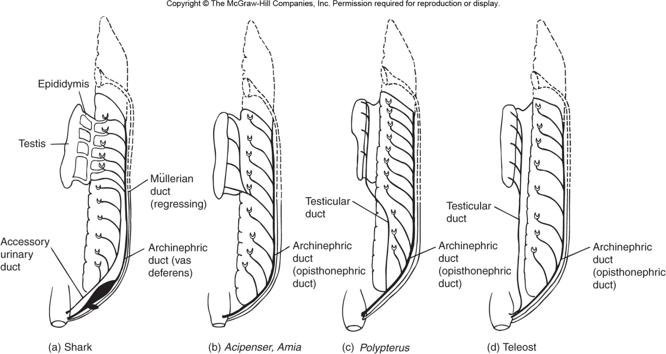
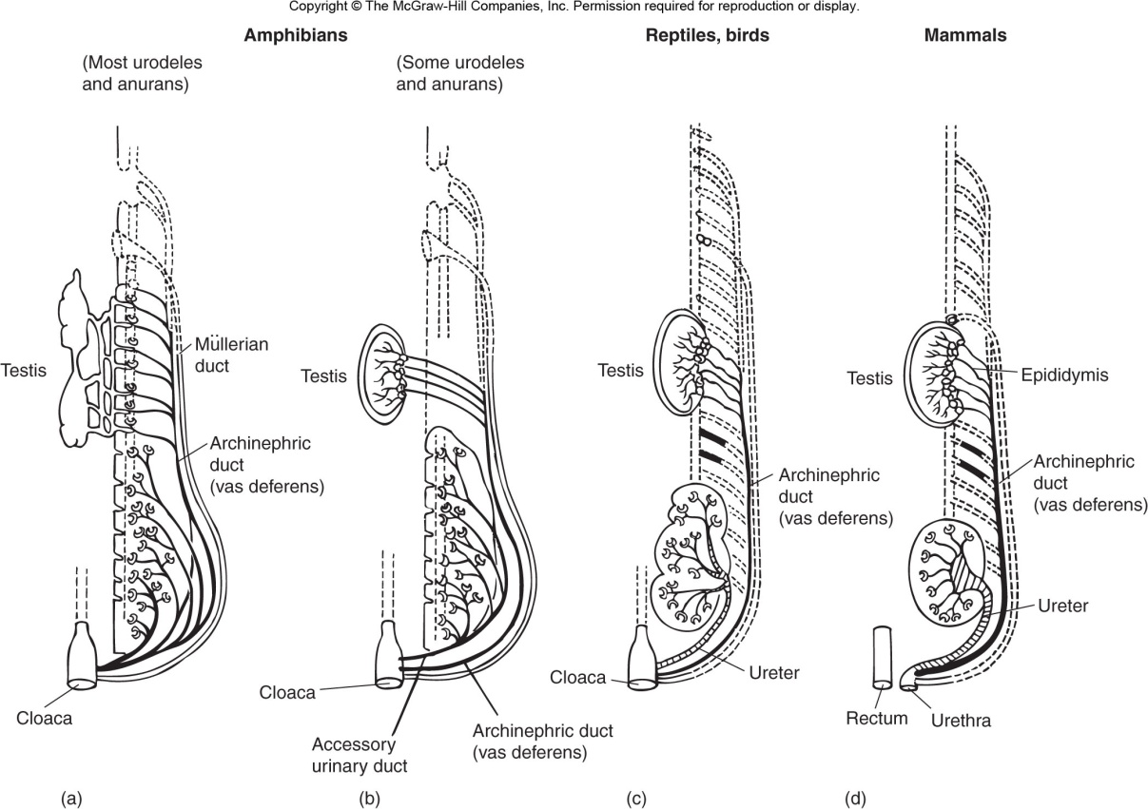
Figs 14.33 & 35 – Urogenital ducts in male vertebrates

Slide 30
Regionalization of Male Tract
Archinephric Duct forms vas deferens
Anterior end of vas deferens becomes convoluted as epididymal duct (serves sperm storage role)
Anterior mesonephric tubules contribute to vas efferens, which connect to rete testis

Slide 31
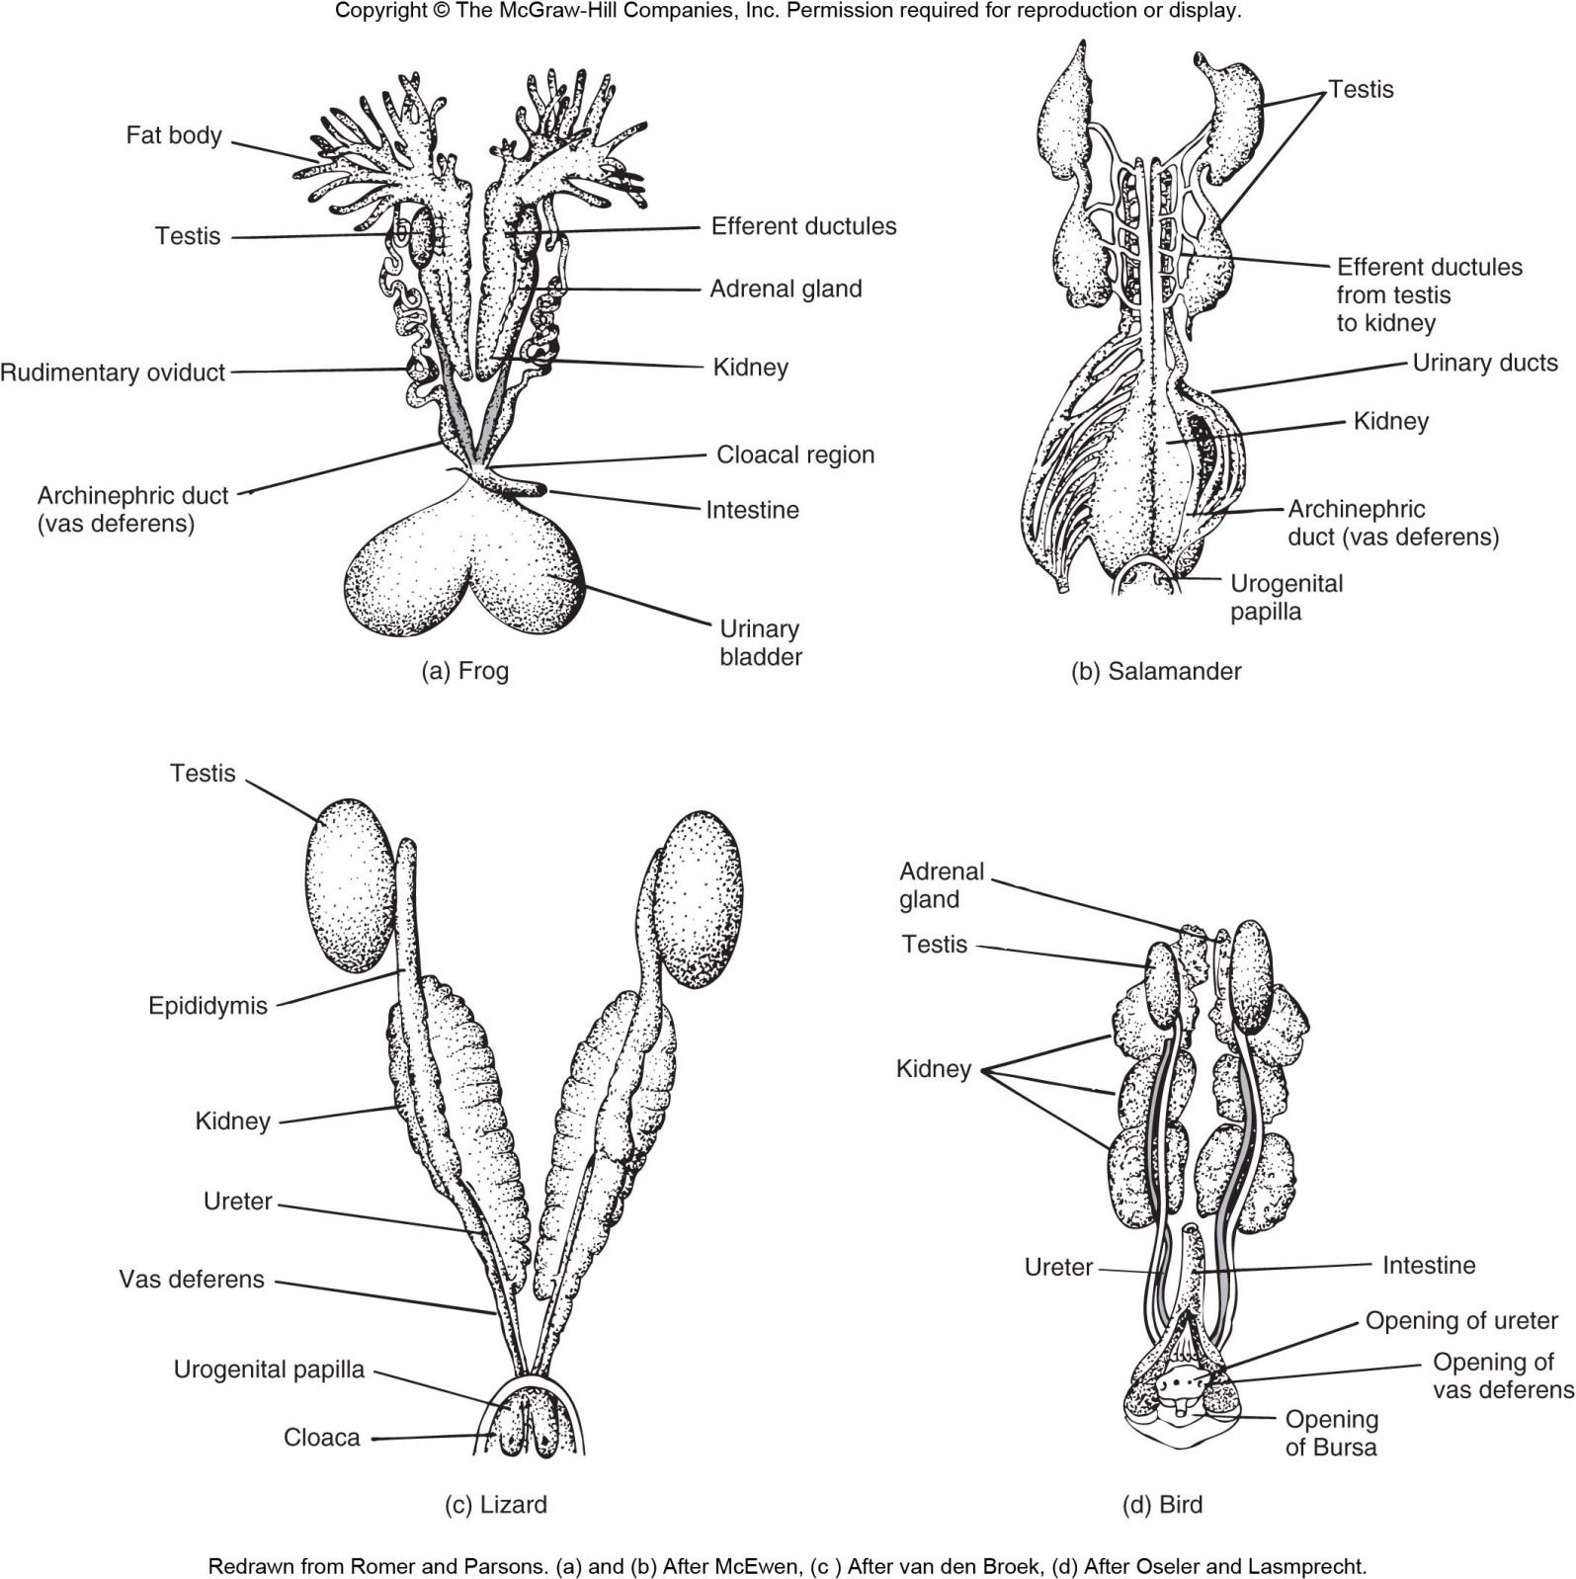
Fig 14. 36 – Male reproductive tracts in vertebrates

Slide 32
Accessory Structures of Vas Deferens
Ampulla = distal expansion for sperm storage (common in Chondrichthyes, Amphibians and Amniotes)
Seminal Vesicles = secrete thick liquid contributing to semen (Mammals)
Prostate = surrounds urethra as it exits bladder, secretes serous fluid with enzymes that help liquify semen (Mammals)
Bulbo-urethral glands = posterior to prostate; secrete mucus contributing to semen (Mammals)

Slide 33
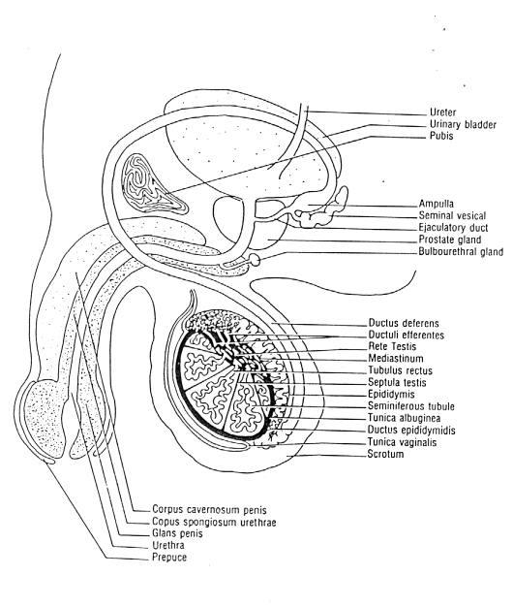
Male Genital Ducts
and Genital Glands in Mammals

Slide 34
Cloaca
Common chamber receiving input from digestive, excretory and reproductive systems
Opens to exterior of body
Found in all vertebrates except mammals
Arises embryonically from hindgut endoderm and proctodeal (skin) ectoderm
Presence of cloaca is primitive condition for vertebrates
Occurs in most primitive gnathostomes
Persists in embyros of almost all vertebrates

Slide 35
Cloaca
Divided into 3 regions:
Coprodeum = anterior region, receives excrement from digestive tract.
Urodeum = middle region, receives waste from urinary system and gametes from reproductive system.
Proctodeum = posterior region, stores digestive and excretory system waste; closed by a muscular sphincter posteriorly.
Absent in some Chondrichthyes (ratfishes), ray-finned fishes, coelocanth and most placental mammals
Loss in these groups independently derived

Slide 36
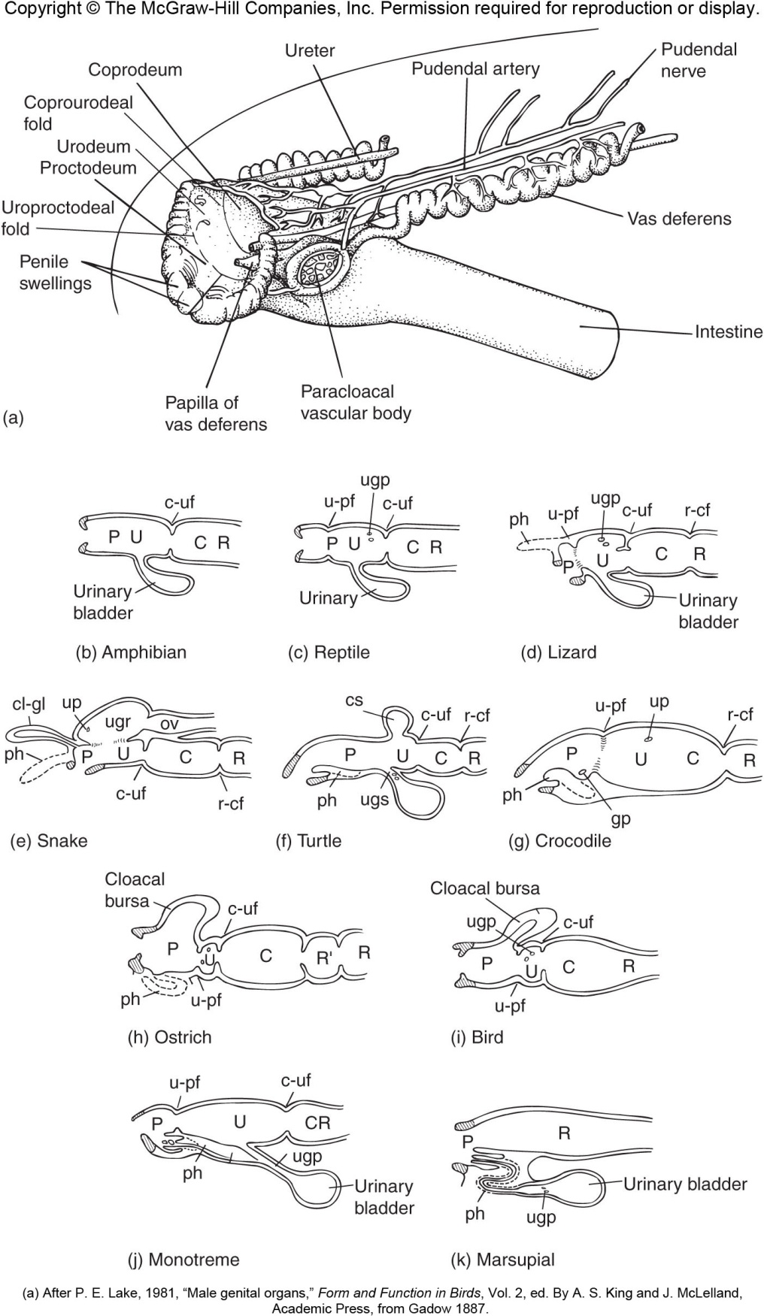
Fig 14.47 – Cloacal structure in different vertebrates

Slide 37
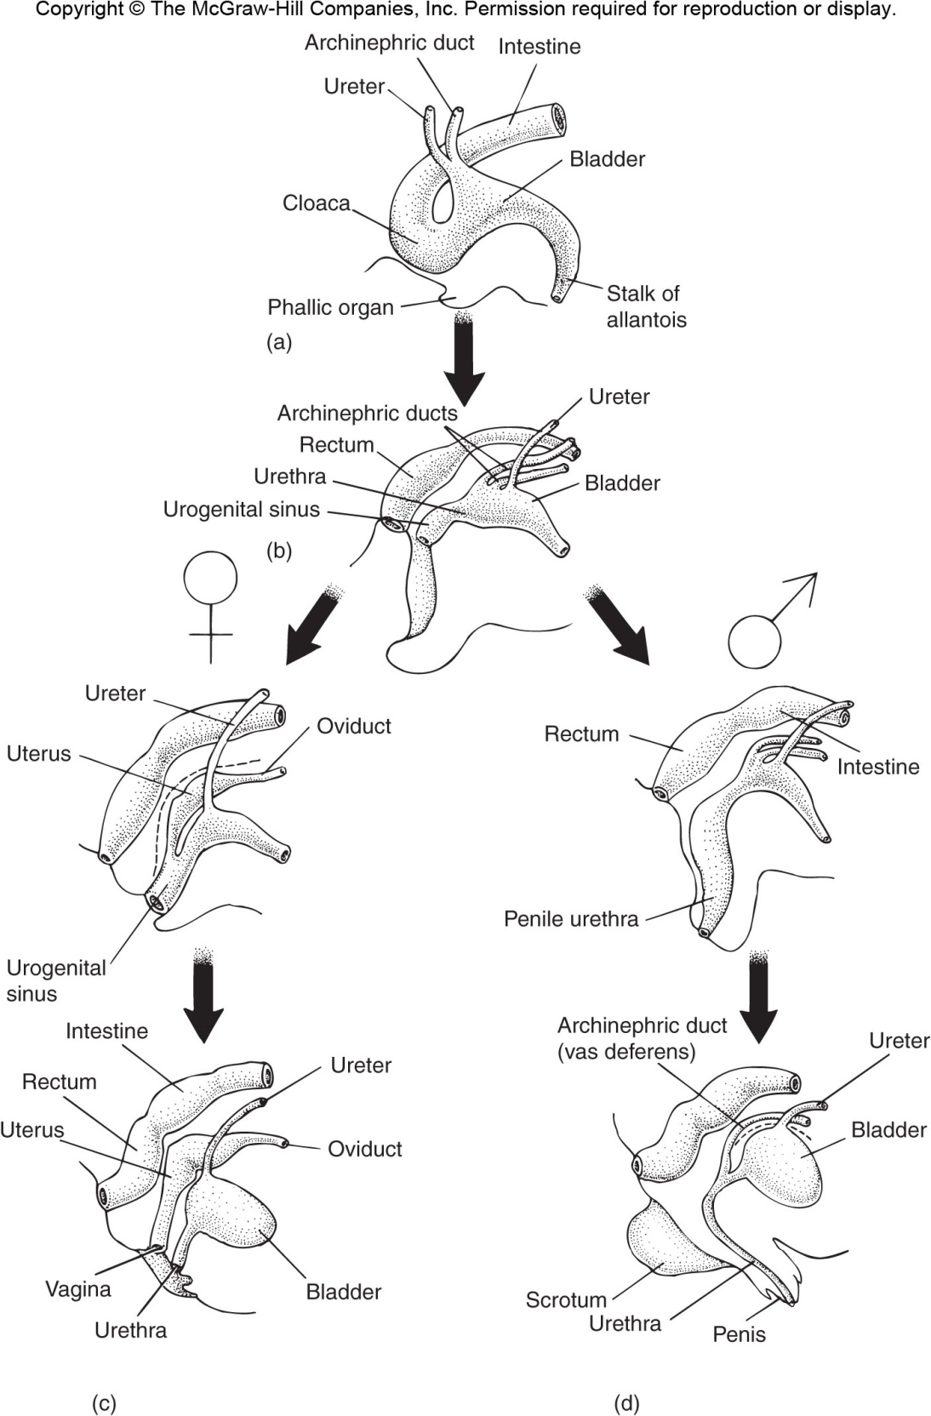
Fig 14.50 – Urogential sinus derivatives in placental mammals

