Slide 1
Great Plains Chapter
Dr. Jake Kerby
University of South Dakota

Slide 2
Outline
Introduction
Amphibian declines
What is FrogWatch?
How do I do a survey?
Tested on Frog Calls
Certified!

Slide 3
Introduction
Coordinators:
Dr. Kerby- Biology Professor at USD
Spencer Siddons- Graduate student
Leigh Spencer- Great Plains Zoo
Please sign in!

Slide 4
Goals
Gain an understanding of amphibians
Learn survey protocol
Learn Frog calls! (It’s ok if it takes awhile)

Slide 5
Welcome! Now take a test!
Notes:
5

Slide 6
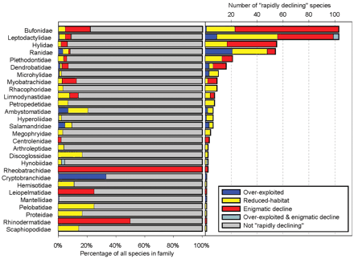
Amphibian Declines
33% of amphibian species threatened with extinction (Stuart et al. 2004)
More than any other vertebrate taxon
Stuart et al., 2004
Notes:
Unprecedented worldwide declines due to global change

Slide 7

Environmental Degradation
Various human impacts:
Habitat destruction
Global climate change
Invasive species
Emerging disease
Emerging contaminants

Slide 8
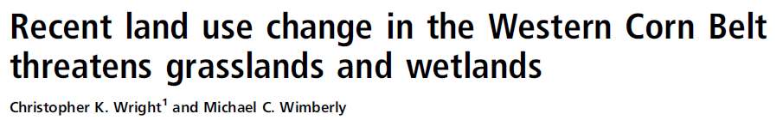

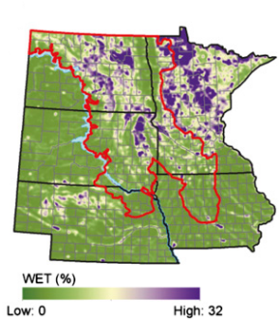
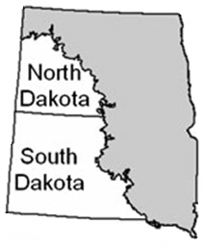
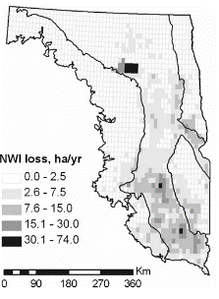
Wetland Loss and Degradation
Pervasive, continuing problem in the US
PPR wetlands are important habitat for amphibians
Increasingly important to prevent degradation of remaining wetlands in the Prairie Pothole Region (PPR)

Slide 9
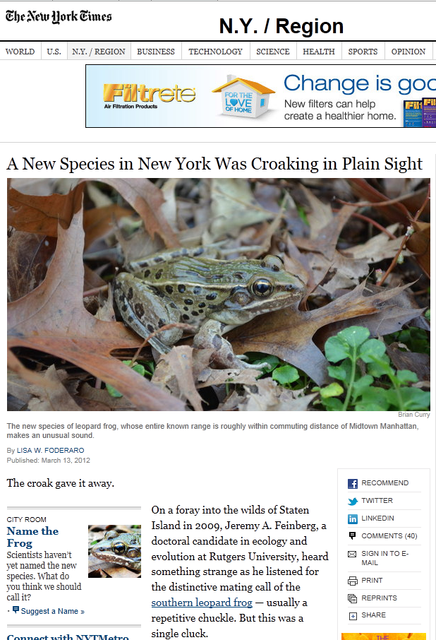
Frog and toad species can be distinguished by the sounds they make in same way songbirds can be identified.
Each species makes unique vocalizations – sometimes calling and genetic analyses are the only way to determine distinct species.

Slide 10
Frogs and Toads of the Dakotas and surrounding states
4 Families
  Ranidae:
  True Frogs
  Hylidae:
  New World Treefrogs
  Bufonidae:
  True Toads
  Scaphiopodidae: Spadefoots
Species Counts
  South Dakota: 13
  North Dakota: 9
  Nebraska: 11
  Minnesota: 14
  Iowa: 17

Slide 11
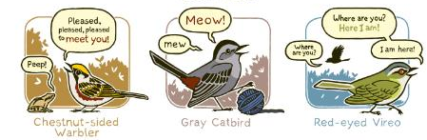

Learning Calls
http://www.birdandmoon.com/birdsounds.html
Develop mnemonics
Study the picture while listening to the call
Sketch the frog and/or the sound it makes
Practice, practice, practice!

Slide 12
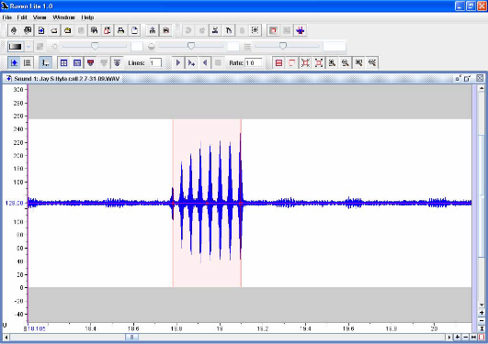
American Bullfrog
Listen
What does it sound like?
Notes:
Note that you may have to extrapolate out to a second for short bursts of calling.

Slide 13
Ranidae: True Frogs (3)
Shared Features
Powerful hind legs
Can move in long leaps
Webbed feet
Stout waist
Large, broad mouth
Smooth skin without bumps
or tubercles (generally)
Species List
Northern Leopard Frog
Plains Leopard Frog
American Bullfrog

Slide 14
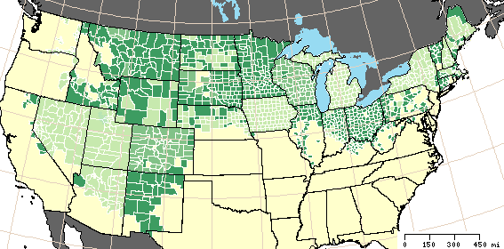
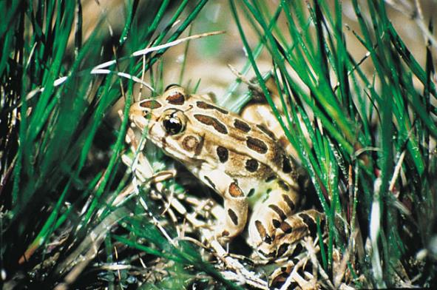
Northern Leopard Frog
Lithobates (Rana) pipiens
© USGS
© INHS
March – June
© USGS
Notes:
14
Green, tan, or brown above, with dark brown oval spots with well-defined edges and pale borders. Creamy white below,
without any dark pigmentation. Cream-colored well-defined dorsolateral folds extend from the shoulders to the rump.
The upper jaw has a whitish stripe.

Slide 15
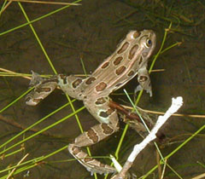
Northern Leopard Frog
Habitat:
Wide variety ranging from freshwater with profuse vegetation to brackish marshes and moist fields.
Call: A low guttural snore lasting about 3 seconds, followed by several clucking notes.
© NPS
Notes:
15
A low gutteral snore-like rattle, which has been compared to a small motor boat engine.

Slide 16
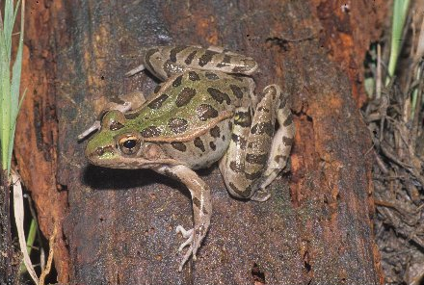
Plains Leopard Frog
Lithobates blairi
Size: 2 - 4 ¼ inches
Distinct white line along the upper lip and a light/ contrasting spot in the center of the tympanum.
Prominent dorsolateral folds that become broken or discontinuous near the thigh.
© Dick Bartlett
Spot
Break

Slide 17
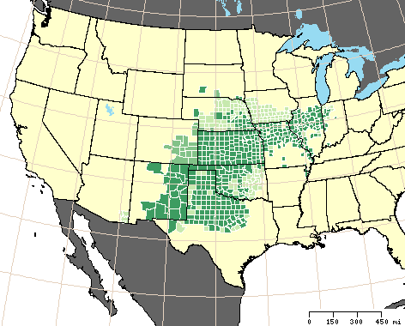
Plains Leopard Frog
Range: Central plains from northern Texas to Kansas and southeastern South Dakota.
Habitat: Associated with plains and prairies, this frog is primarily aquatic, but may be far from permanent and semi-permanent wetlands during extended rainy periods.
© USGS

Slide 18
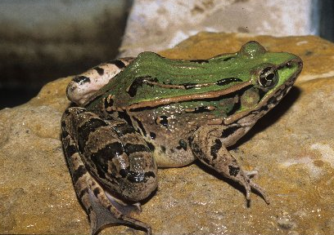
Plains Leopard Frog
Call:
Two to four abrupt, guttural notes that sound squeezed.
Chu-hu-huck, chu-hu-huck, chu-hu-huck
Repeated in rapid succession with each sounding slightly raised in pitch and ending in an accent.
© Dick Bartlett

Slide 19
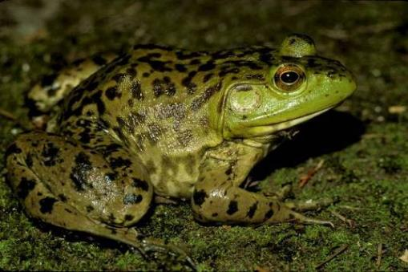
American Bullfrog
Lithobates catesbianus
(formerly Rana catesbeiana)
Size: 3 – 8 inches.
The largest frog in
North America.
Large specimens have been
known to catch and swallow
small birds and young snakes… and smaller frogs.
© USGS

Slide 20
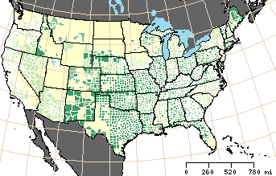
American Bullfrog
Range:
Eastern US; Introduced in the West.
Habitat: Ponds, lakes, slow-moving streams with vegetation. (Must be large enough to avoid crowding).
© USGS

Slide 21
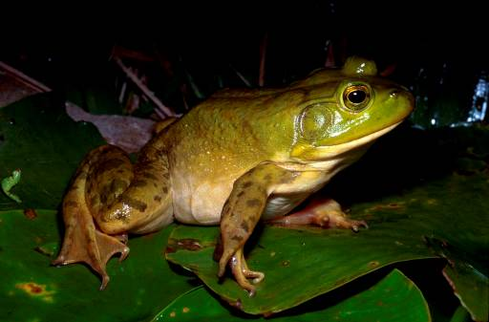
American Bullfrog
Call: Deep-pitched “jug o'rum” resembling the bellow of a bull.
Sound produced by a single internal vocal sac that inflates to form a bulge under the chin.
Call can be heard for more than a quarter mile.
April - August
© Jim Harding, MSU

Slide 22
Ranid test
Write the species!

Slide 23


What is FrogWatch USA?
Nationwide breeding call survey of anurans
Created in 1998
Association of Zoos and Aquariums currently manages
Standardized protocol
Data submitted to online database or national office

Slide 24
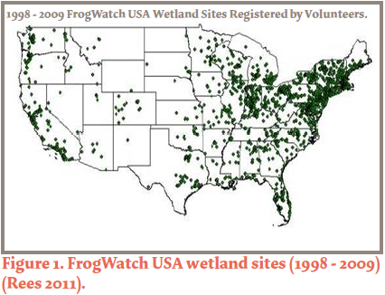
Current Activity
10,500 volunteers from all 50 states
3,500 wetland sites
500 annual volunteers

Slide 25
Great Plains Chapter
Established last year
Website: dakotaherps.org
Second training in Vermillion on April 25th

Slide 26
Why is this useful?
My laboratory can only sample a few sites at a time.
I am consulted by the state to make decisions about conservation status.
Your data can help us locate wetlands and species across the state!

Slide 27
Where should I sample?
Public land
Private land (with permission)
Wetlands, Rivers, Streams, Ponds
In town, out in country
Not limited to South Dakota

Slide 28
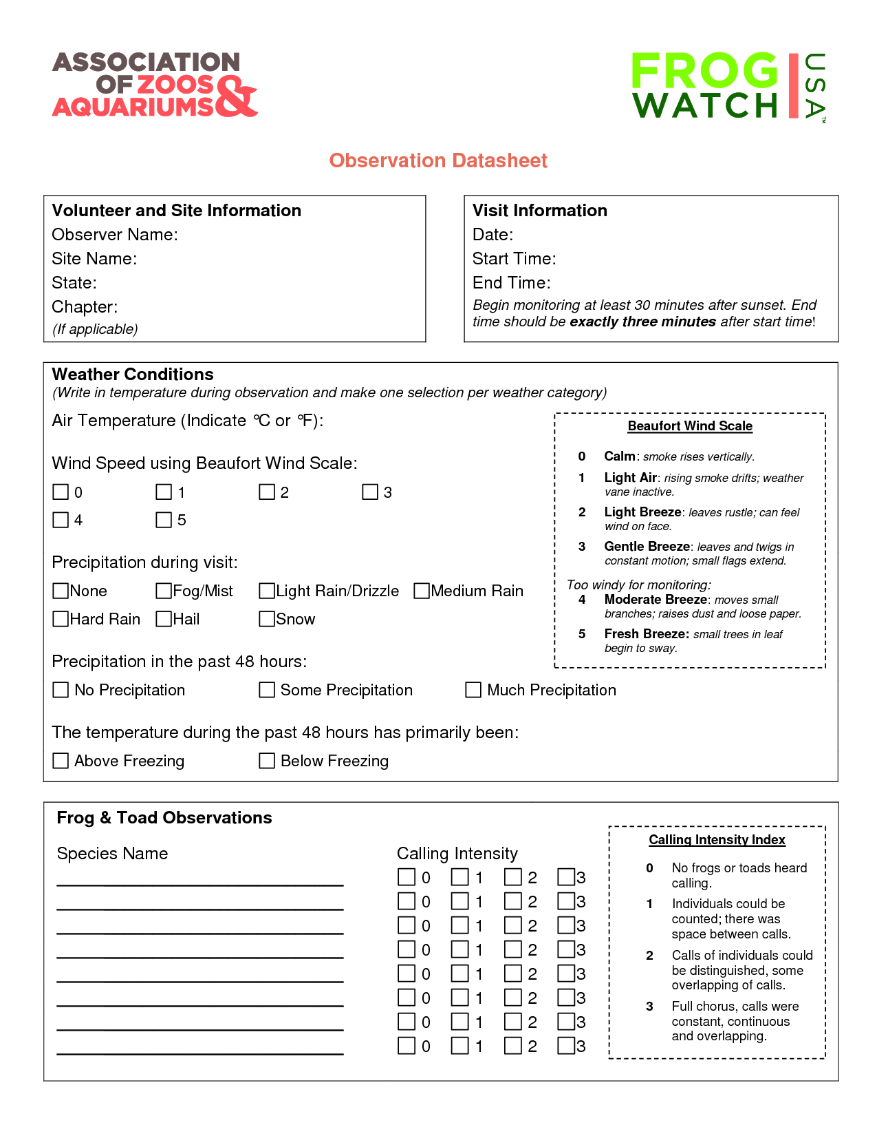
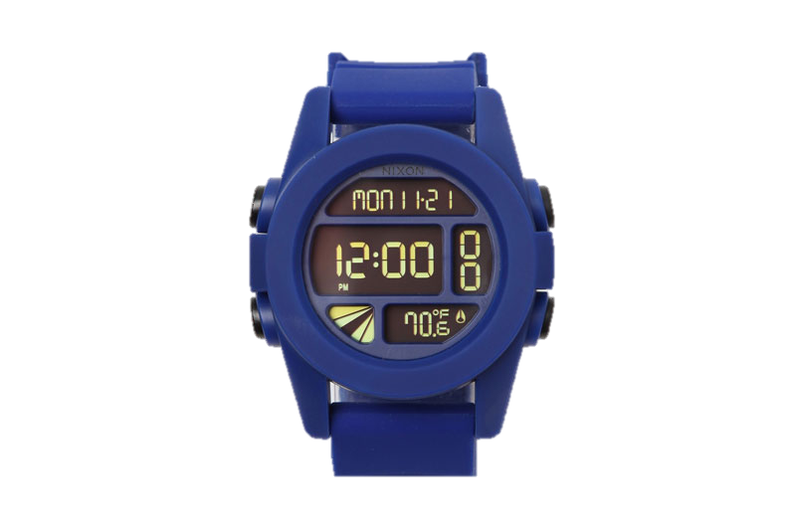
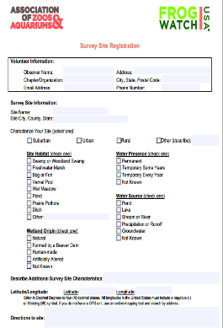
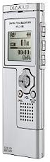
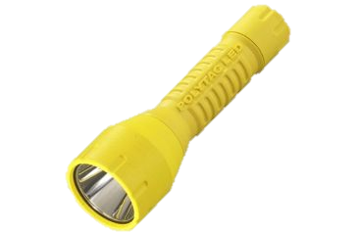
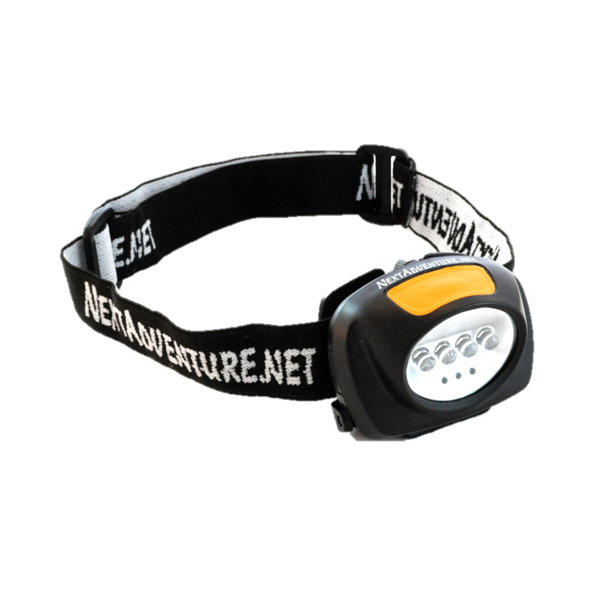
Gearing Up
Data sheets
  Clipboard
Watch
Flashlight/headlamp
Recording device

Slide 29
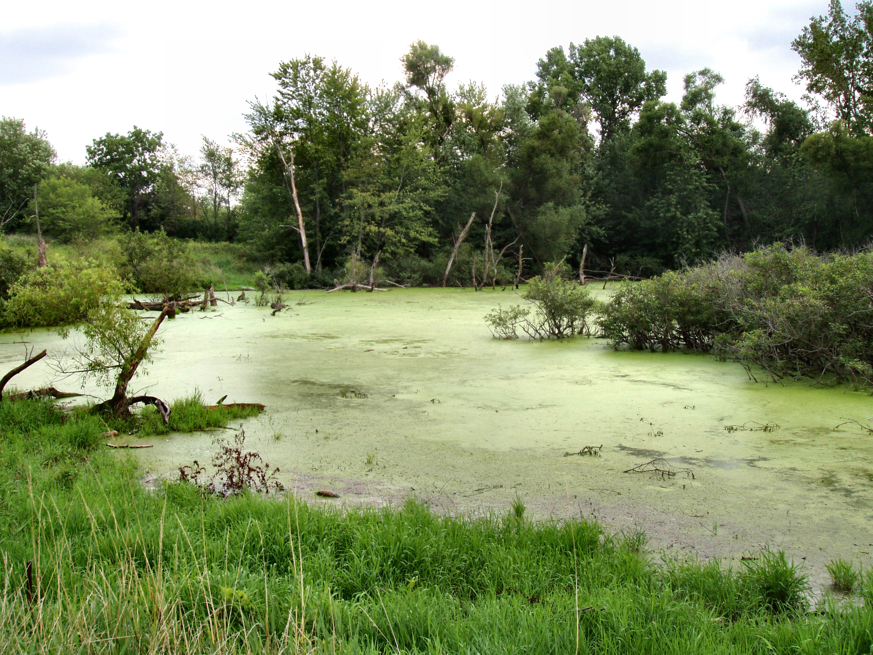
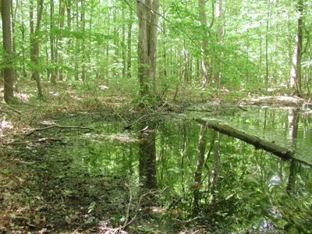
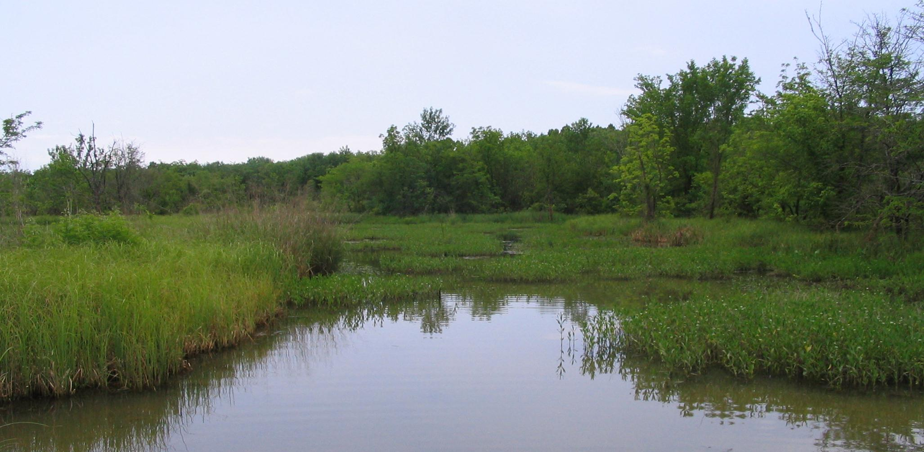
What is a wetland?
“where water is the primary factor controlling the environment and the associated plant and animal life” (Niering 1985)
An area saturated or covered with water for all or most of the growing season

Slide 30
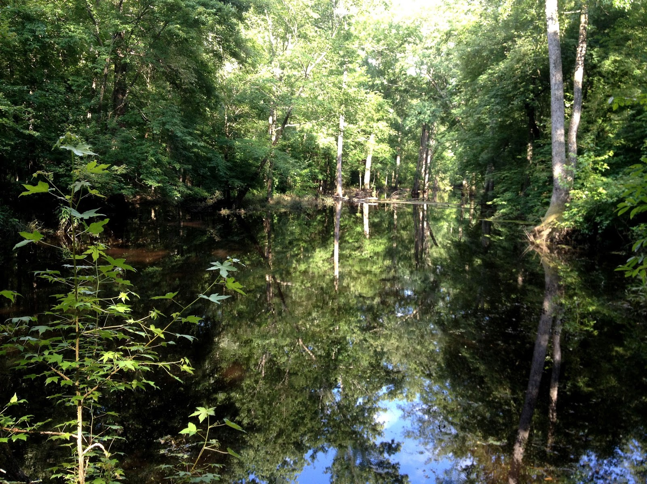
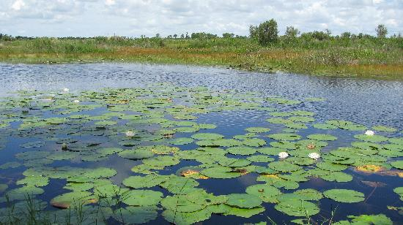
Site Habitat
Swamp or Woodland Swamp
Freshwater Marsh
Woody plants dominate
Standing water
No woody plants
Standing water constant

Slide 31
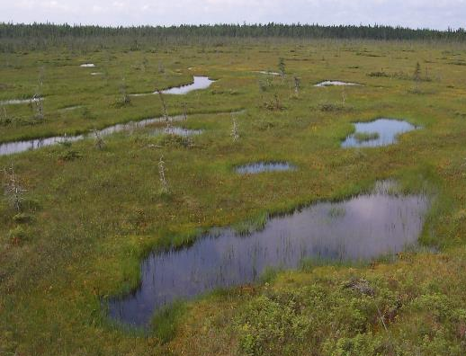
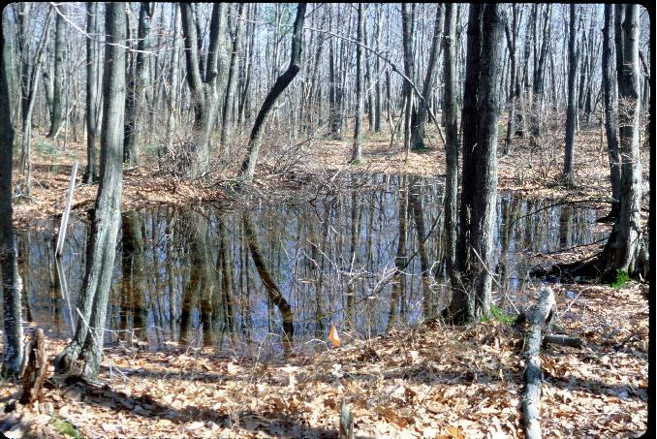
Site Habitat
Bog/Fen
Vernal Pool
Plants cover
Fen: fed by groundwater/streams
Short presence
Filled by snowmelt/rains

Slide 32
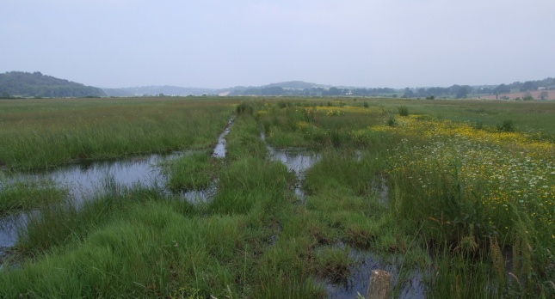
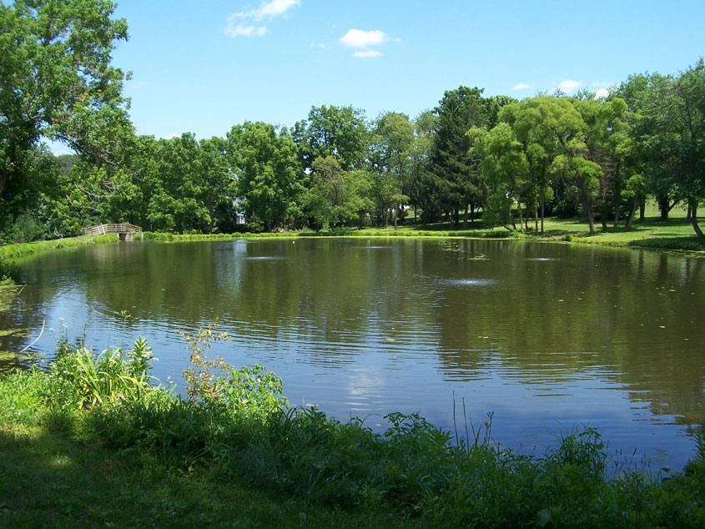
Site Habitat
Wet Meadow
Pond
Poorly drained
Low-lying farms
Usually without standing water
Smaller, shallower than lake
Light reaches bottom

Slide 33
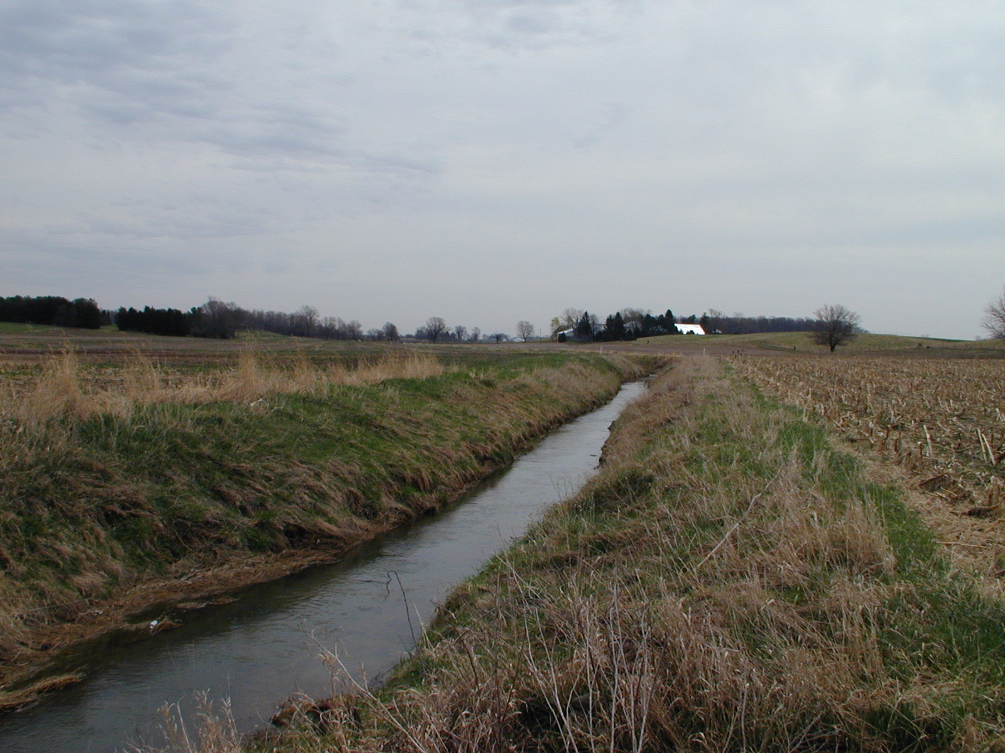
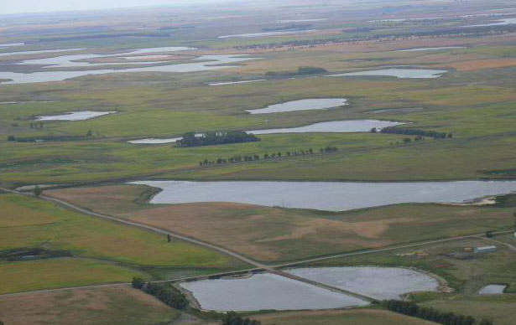
Site Habitat
Ditch
Prairie Pothole
Roadside, agricultural
Filled by runoff
Shallow
Filled by snowmelt, spring rain

Slide 34
Ranid reminder
Yell the species!

Slide 35
Hylidae: New World Treefrogs (4)
Shared Features
Slim waist
Long, thin limbs
Distinctly enlarged toe pads
Ability to climb
Hyla sp.: Treefrogs
(Eastern) Gray Treefrog
Cope’s Gray Treefrog
Pseudacris sp.: Chorus Frogs
Boreal Chorus Frog
Acris sp.: Cricket Frogs
Northern Cricket Frog
(Subspecies - Blanchard’s)
Notes:
- Body size, size and shape of toe pads, and how arboreal varies among species

Slide 36
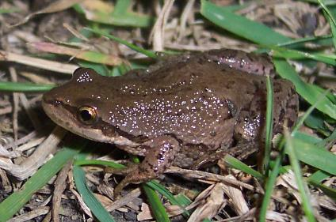
Boreal Chorus Frog
(Pseudacris maculata)
Size: ¾ to 1 ½ inches
Back has three continuous dark stripes or broken dark spots in three rows.
There are stripes or blotches that pass through the eye and meet a light upper lip line.
http://upload.wikimedia.org/wikipedia/commons/1/1a/Pseudacris_maculata.jpg

Slide 37
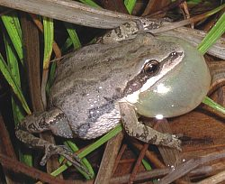
Boreal Chorus Frog
Habitat: Found in and around marshes, lakes, and semi-permanent pools. Breed in semi-permanent wetlands and seasonal pools.
Call: Rapid series of metallic clicks that rise in pitch – “crrreeeeek!” Repeated with two or three seconds of silence in between.
© Ohio Department of Natural Resources Division of Wildlife
http://upload.wikimedia.org/wikipedia/commons/e/ef/Pseudacris_triseriata.jpg

Slide 38
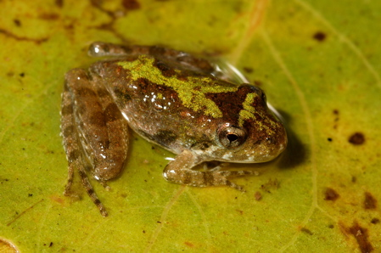
Northern Cricket Frog
(Acris crepitans)
Triangle
Webbing
© Jim Harding, MSU
Notes:
Three subspecies of northern cricket frogs are recognized: Blanchard's (A. c. blanchardi), eastern (A. c. crepitans), and coastal (A. c. paludicola). Blanchard's cricket frogs are represented in the West and Midwest; eastern cricket frogs are found in east Texas, the Gulf Coast and southern forest regions, and the Piedmont north to New York; coastal cricket frogs are found in the Gulf Coast region of western Louisiana and eastern Texas.

Slide 39
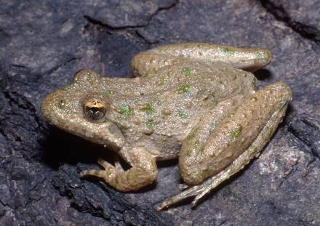
Northern Cricket Frog
Size: 5/8 - 1 ½ inches
Among the most agile leapers and can jump surprisingly long distances (5 - 6 feet) for its small size.
Habitat: Sunny ponds of shallow water with good growth of vegetation in the water or on the shore; slow-moving streams with sunny banks
© Jim Harding, MSU

Slide 40
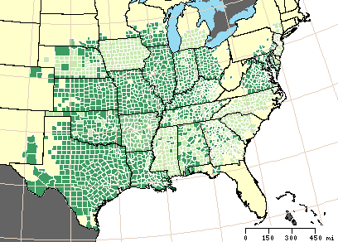
Northern Cricket Frog
Range: Southern New York to Florida panhandle; west to Texas.
© USGS

Slide 41
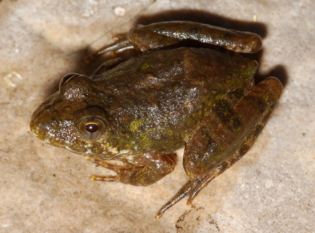
Northern Cricket Frog
Call: Sharp, measured clicking, repeated in rapid succession.
Call reminiscent of two glass marbles being tapped together or the shaking of a spray paint can.
Call produced through a single vocal sac.
© Jim Harding, MSU

Slide 42
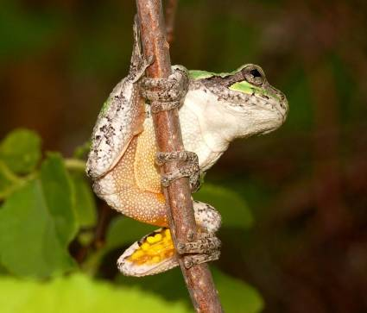
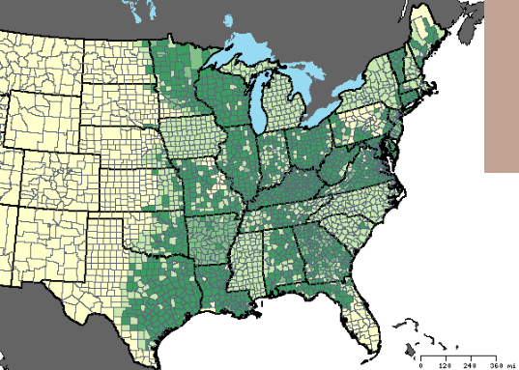
Gray Treefrog Complex
(Hyla versicolor/chrysoscelis Complex)
Light Blotch
Toe Pads
© Jim Harding, MSU

Slide 43
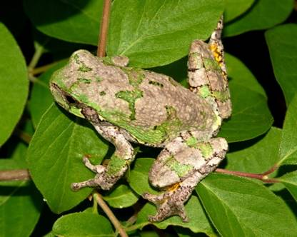
Gray Treefrog Species Complex
Size: 1 ¼ - 2 ½ inches
Two species of gray treefrog are identical in appearance. The difference is the call.
Gray treefrogs can change color from green to gray.
Habitat: Trees or shrubs growing in or near permanent water
© Jim Harding, MSU

Slide 44
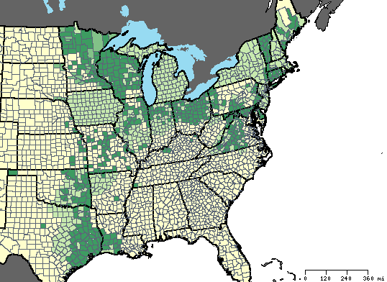
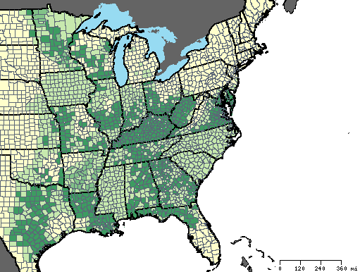
Gray Treefrog
(Hyla versicolor)
Cope’s Gray Treefrog
(Hyla chrysoscelis)
© USGS
© USGS
Range: From MN to FL west to TX.
Range: MN South to TX and across to FL.

Slide 45
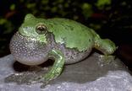
Gray Treefrog
Call: A hearty, resonating trill, usually heard in spring and early summer. Clear and rippling.
The Cope’s gray treefrog has half as many chromosomes as the gray treefrog. Its call is a faster, raspier less musical trill.
© Jim Harding, MSU
© Jim Harding, MSU

Slide 46
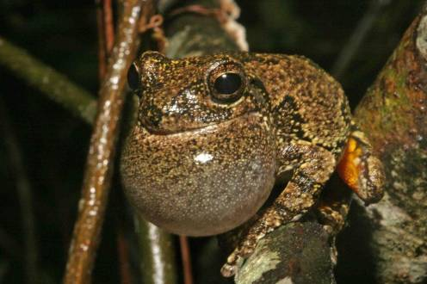
Cope’s Gray Treefrog
Call: A hearty, raspy resonating trill, usually heard in spring and early summer.
Faster trill that is less musical than that of the identical-looking gray treefrog
© Dick Bartlett

Slide 47
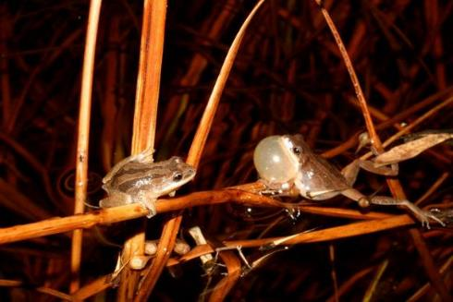
Hylid test!
Remember your clues

Slide 48
What if I forget the calls?
Lots of resources on internet!
Record calls you are not sure of.
Catch the frogs if you are not sure.

Slide 49
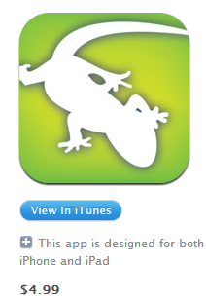


Frog Call Resources
USGS Frog Call Lookup & Quiz
http://www.pwrc.usgs.gov/frogquiz/
eNature
http://www.enature.com
Cornell Lab of Ornithology Macaulay Library
http://macaulaylibrary.org
AmphibiaWeb
http://amphibiaweb.org
DakotaHerps.org
Audubon app available
through iTunes

Slide 50

Additional Tips
Localize a species list
  Consider physiographic province
  and habitat types
  National Amphibian Atlas
  http://armi.usgs.gov/national_amphibian_atlas.php
Printed materials and field guides
Consult local resources
(e.g., state agencies)
Contact local experts
New App available
through iTunes!

Slide 51
More than one call?!
Advertisement (breeding) call – dominant sound heard during breeding season.
Aggressive (agonistic) call – a grunt, growl, or trill sounded by a male when defending a calling site.
Release call – a chirp-like sound accompanied by body vibrations.
Rain call – Weak version of the advertisement call, typically following rain events outside the breeding season.
Alarm call - a loud squeak emitted as a frog attempts to escape a predator.
Notes:
Monitoring for advertisement calls, but be aware of other types so not to mistake for an alternate species.
Advertisement call – made by males, it is the dominant sound heard during the breeding season and is usually quite loud. It is distinctive for each species and presumably advertises the male’s presence to other members of its species, defining calling sites and attracting females to the breeding area. The call of an individual male’s call probably influences his attractiveness to females (White & White 2002 – Amphibians and Reptiles of Delmarva)
Rain call – Usually a weak version of the advertisement call, typically following rain events outside the breeding season.
Release call – often a chirp-like sound, usually accompanied by body vibrations, emitted mostly by males to discourage other males that are mistakenly attempting to mount them or by females that are trying to thwart or terminate mating (most often the former).
Alarm call – a loud squeak emitted as a frog attempts to escape a predator.
Aggressive call – Often a grunt, growl, or trill sounded by a male when defending a calling site, made typically in head-to-head encounters

Slide 52
General Factors Influencing Calling
Temporal – varies year-to-year.
Spatial – from location-to-location, across elevations.
Abiotic factors – Weather and environmental conditions.

Slide 53
Factors Influencing Call Intensity
Time of year – have a surge in activity that will decrease as the season progresses.
Time of day – peaks after sunset and tapers off around midnight
Precipitation – activity tends to increase following rain events.

Slide 54
Factors Influencing Call Quality
Temperature – the lower (colder) the temperature, the slower the call.
Size of individual calling – the larger the individual, the lower the call.
Acoustic interference – evidence suggests that frogs may call higher and less frequently.

Slide 55
HELP!
Calls can be difficult to tell apart
One clue can be where you are in the state
  Don’t rely on this too heavily: YOU could find a species never heard there before!
Visual verification (AFTER the survey)
Go back! Record. Ask for help.

Slide 56
When should I sample?
FrogWatch members have a specific protocol about time of day, but as much as as often as you can!

Slide 57

Monitoring Protocol
Volunteer and Site Info.
    Prior to monitoring
Begin at least 30 min after sunset
    Wait 2 minutes
    Cup ear, listen 3 minutes
    Start/End Time = 3 Minutes
Consider severe or inappropriate weather
Noise pollution
Notes:
Site Name?

Slide 58
Weather Information
Notes:
“Fresh Breeze”?
Why might precip or temperature be important?

Slide 59

Call Observations
Wait 2 minutes
Listen for 3 minutes

Slide 60
Calling Phenology for SD Species
Common Name | Scientific Name | Jan | Feb | Mar | Apr | May | Jun | Jul | Aug | Sep | Oct | Nov | Dec
Boreal Chorus Frog | Pseudacris maculata
Wood Frog | Lithobates sylvaticus
Northern Leopard Frog | Lithobates pipiens
Plains Leopard Frog | Lithobates blairi
American Toad | Anaxyrus americanus
Woodhouse’s Toad | Anaxyrus woodhousi
Great Plains Toad | Anaxyrus cognatus
Canadian Toad | Anaxyrus hemiophrys
Eastern Gray Treefrog | Hyla veriscolor
Cope’s Gray Treefrog | Hyla chrysoscelis
Plains Spadefoot | Spea bombifrons
American Bullfrog | Lithobates catesbianus
Northern (Blanchard's) Cricket Frog | Acris crepitans blanchardi
Sources:
A Field Guide to South Dakota Amphibians (pub. 1999) - Green
Kansas Herpetological Atlas - Gray
Kansas Amphibian Monitoring Program - Gray
Notes:
60

Slide 61
Ranid and Hylid Revamp
Remember your clues

Slide 62
Bufonidae: True Toads (4)
Shared Features
Relatively thick, dry, warty skin
Enlarged (paratoid) glands at the shoulder region
Stout-bodied and move in short hops
Ground-dwelling
Species List
American Toad
Dakota (Canadian) Toad
Woodhouse’s Toad
Great Plains Toad
Notes:
62
Hybridization among Fowler’s, Woodhouse’s, American, and Southern Toads sometimes make it impossible to identify these species by appearance alone – the distinct and unique call of each species becomes extremely important.

Slide 63


American Toad
(Anaxyrus americanus)
Formerly Bufo americanus
Glands behind ridge
© USGS
Habitat:
Mowed grassy yards to forested mountains. Wherever there is abundant moisture and insects. Reproduce in virtually any shallow and fish-free water body.
Notes:
American Toad Range: From Canada through New England, and the Appalachian Mountains; west from Georgia through Missouri.
Fowler’s Toad Range: Lake Michigan east through most of Pennsylvania to New York and New England, south to the Gulf coast, west to Texas.
63

Slide 64

American Toad
Call: A pleasant musical trill lasting 5 to 30 seconds.
Call sounds like a simultaneous whistle and hum.
Single vocal sac that is large, round, and prominent when inflated.
© Joe Greathouse, Oglebay’s Good Zoo

Slide 65


Dakota (Canadian) Toad
(Anaxyrus hemiophrys)
Formerly Bufo hemiophrys
© USGS
Habitat:
Mowed grassy yards to forested mountains. Wherever there is abundant moisture and insects. Reproduce in virtually any shallow and fish-free water body.
Notes:
American Toad Range: From Canada through New England, and the Appalachian Mountains; west from Georgia through Missouri.
Fowler’s Toad Range: Lake Michigan east through most of Pennsylvania to New York and New England, south to the Gulf coast, west to Texas.
65

Slide 66

Dakota (Canadian) Toad
Call: A trill similar to American Toad, but lower in pitch and shorter in time.
Call sounds like a simultaneous whistle and hum.
Single vocal sac that is large, round, and prominent when inflated.
B. Oldfield

Slide 67

Woodhouse’s Toad
Size:
2 – 4 ½ inches
White stripe down middle of back.
White belly (American Toad is spotted)
© USFWS
Notes:
Named for Samuel Washington Woodhouse (1821-1904), a naturalist and assistant surgeon who accompanied a U.S. Army expedition to the southwest in 1851.

Slide 68

Woodhouse’s Toad
Range:
Throughout the Central United States.
Hybridizes with American Toad (A. fowleri) in the eastern part of its range.
Tend to be near Missouri River more often than American Toads.
© USGS

Slide 69

Woodhouse’s Toad
Call:
A short, nasal
w-a-a-a-h lasting 1-3 seconds.
Similar to
A. fowleri but lower in pitch.
Habitat:
Can live in a variety of places from marshes, streambanks, and woods to a common backyard garden.
© NPS
Notes:
This species sounds like a nasal "w-a-a-a-h" lasting 1-2 seconds, similar to Fowler's toad (Bufo fowleri) but lower in pitch.

Slide 70

Great Plains Toad
Anaxyrus (Bufo) cognatus
Size:
2 – 4 ½ inches
Bold back pattern of large blotches containing many warts.
Explosive breeder following heavy rains.
© NPS
Notes:
This species sounds like a metallic trill, repeated at short intervals.

Slide 71

Great Plains Toad
Range:
East of the Rocky Mountains to Missouri; Mountain South into Texas.
Habitat:
Grasslands of the prairie and drier bushy areas. Breeds in river floodplains, ponds, ditches, and flooded fields.
© USGS

Slide 72

Great Plains Toad
Call:
An extended pulsating, metallic rattle or trill.
May resemble a drill or sound from a toy.
Male’s vocal sac is large and curved like a sausage.
© NPS

Slide 73
Pelobatidae: Spadefoots (1)
Shared Features
Sickle-shaped spade on inside of each hind foot
Vertical, elliptical pupils
Tubercles on skin
Stout w/broad mouth & short legs
Primarily fossorial
(dig underground)
Species List
Plains Spadefoot

Slide 74

Plains Spadefoot
Spea bombifrons
Size: 1 ½ - 2 ½ inches
Close set eyes with raised area in between.
Scattered yellow to orange tubercles scattered on back and legs.
© Dick Bartlett

Slide 75

Plains Spadefoot
Range:
Spans from Texas and Arizona northward to Canada.
Habitat:
Primarily a plains and prairie species; inhabits grassland, sage-brush, and grassy farmland.
© USGS

Slide 76

Plains Spadefoot
Call:
Raspy hack repeated once every one to two seconds.
© Dick Bartlett

Slide 77
Toad test!
Remember your clues
© Dick Bartlett

Slide 78


Available Listening Sites

Slide 79


Getting Started
Register on frogwatch.fieldscope.org/
Must be logged into account to enter data
    Upper right-hand corner
Enter data, explore maps, and make graphs

Slide 80



Registering Site
Enter Data -> Select Station -> Create New Station
Make name UNIQUE
Coordinates:
    Click on wetland in map
    Enter GPS Coordinates
Coordinates in decimal degrees
  Longitude is negative
      Minimum of four decimal places

Slide 81

Entering Monitoring Data
Enter site and call data
Save data entry
Flagging Data:
      Questionable data

Slide 82



Analyzing Data

Slide 83
Let’s enter data
Fieldscope.com

Slide 84
Time to practice!
New Jersey Chorus Frogs
© Will Lattea

Slide 85

Haven’t had enough?!
Separate Citizen Science Program
  National Park Service sponsored program
  Bow Creek and other site surveys
  More than calls- identify eggs and larvae

Slide 86
Stations
Register account and sites
Identify species visually
Re-test for certification

Slide 87
Thanks!
It takes practice and time to learn calls
  Don’t expect to be an expert after one session
  Use online resources
  Please register a site and sample repeatedly!
  Share this with friends outside of the area!

